Slide 1
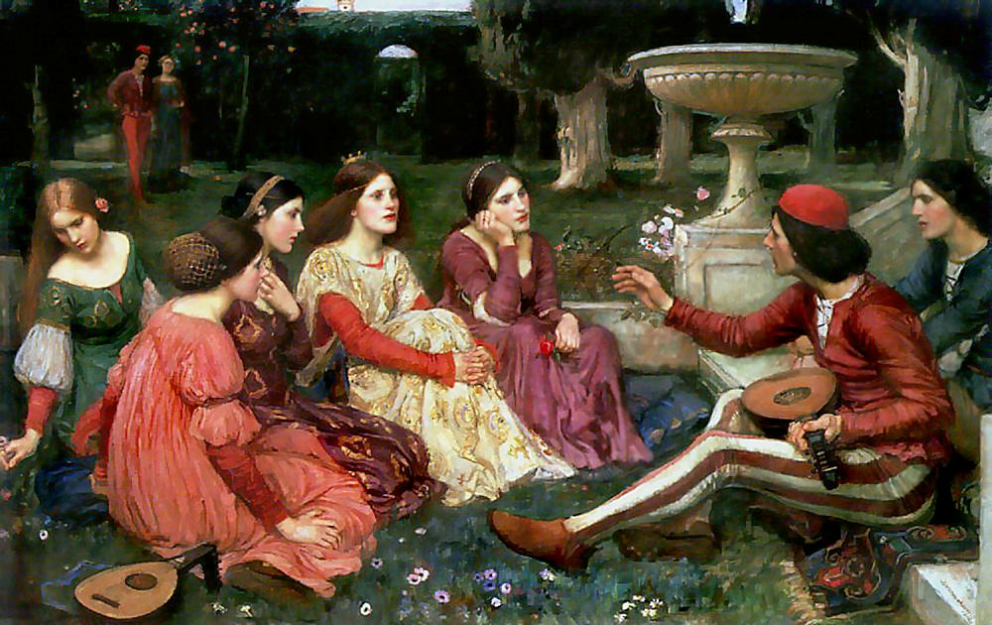
La “lieta brigata”
The merry band

Slide 2

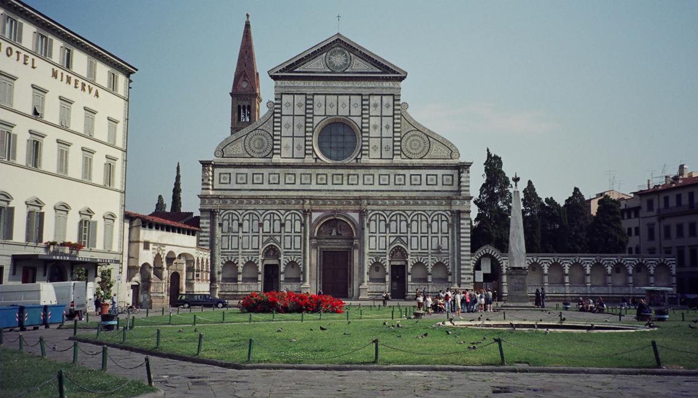
MEETING OF TEN GUYS IN THE CHURCH OF S. MARIA NOVELLA

Slide 3
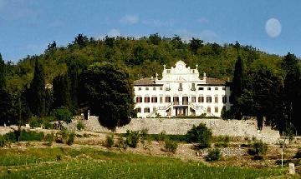
WHITDRAW IN THE COUNTRY TO ESCAPE FROM THE PLAGUE

Slide 4
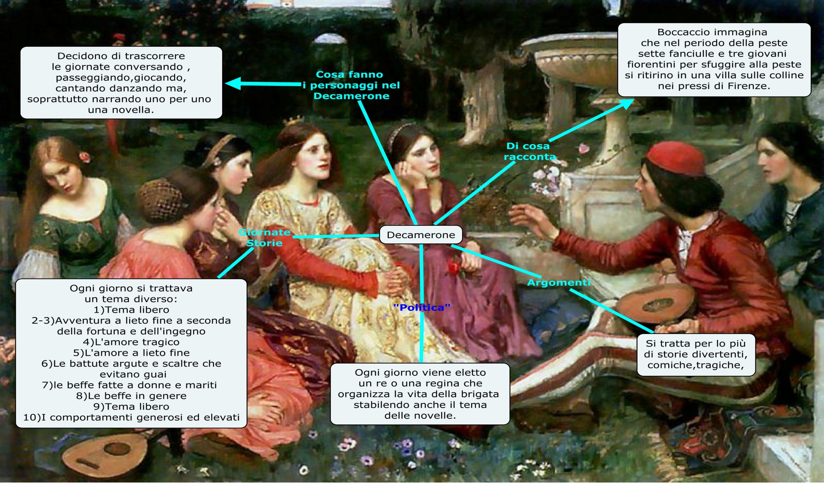
THE GUYS TO PASS THE TIME TELL NOVELLES

Slide 5
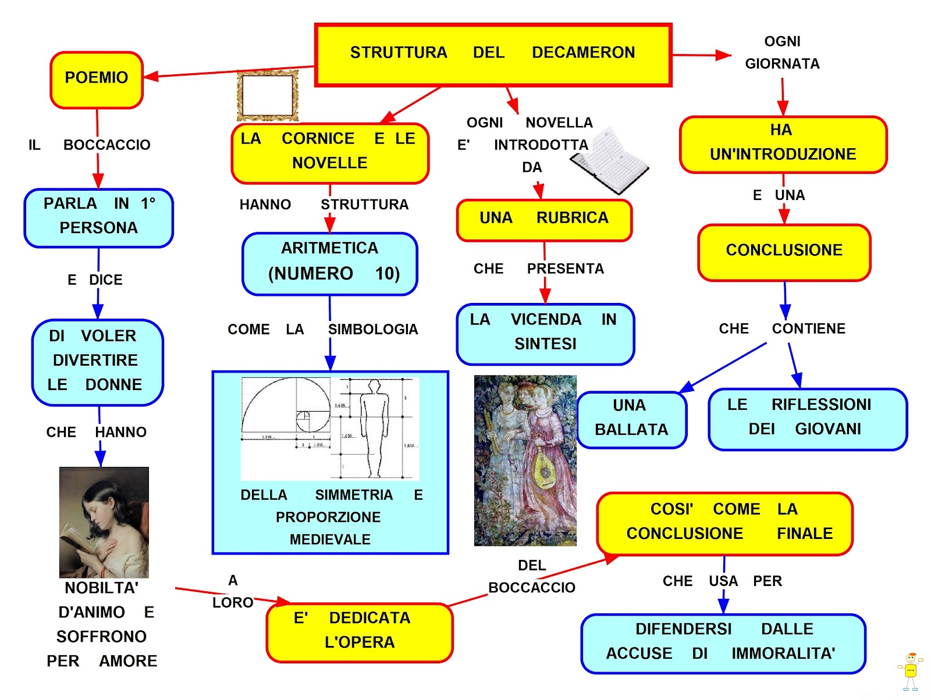
THE ORGANIZATION FOR THE TELLING OF THE NOVELLES

Slide 6

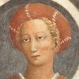
Pampinèa
The "luxuriant," mature woman and intellectually wise.

Slide 7
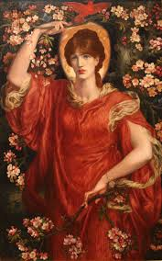
Fiammetta
Is the ardent of love

Slide 8
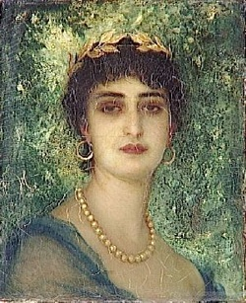
Filomena
Almost a replica of Pampinea, she is the
"beloved"

Slide 9
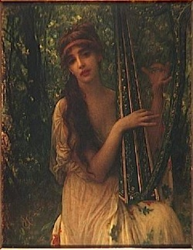
Emilia
The “flattering” or “vague of her beauty”

Slide 10
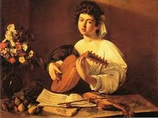
Elissa
The one that was abbandoned

Slide 11
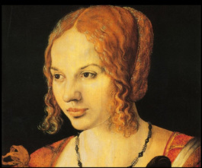
Lauretta
“The plaintive”

Slide 12
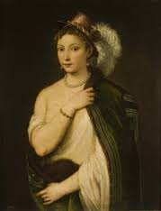
Neìfile
“The new to love”

Slide 13
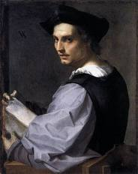
Filòstrato
Is the image of unhappy love

Slide 14
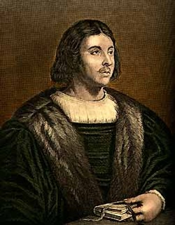
Pànfilo
Decides the theme of the novels of the tenth day, is “the one who has the great spirit”

Slide 15
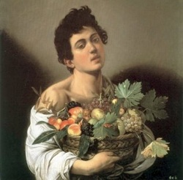
Dionèo
Embodies the spirit of burlesque and unconventional of the book

Slide 16

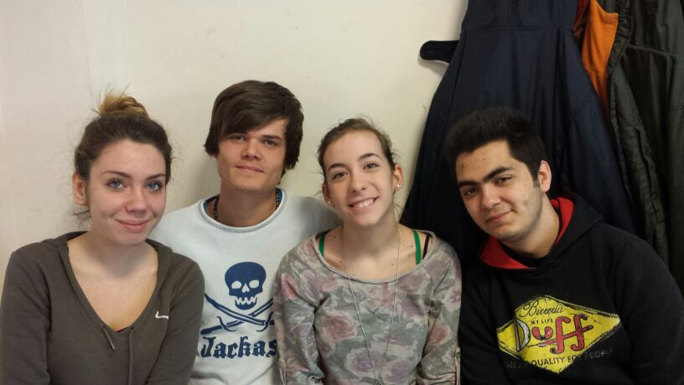
We are the merry company

Slide 17
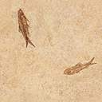
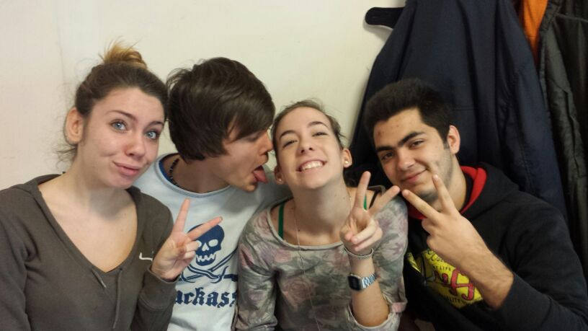
Yeeeee 3ATC A.S 2013/2014
Adam
Debora
Michele
Viola

