Slide 1




Was he really dracula?
Reading practice for the students of the zsp NO 1 in zamość
The Reading Plan which is
the Zespol Szkol Ponadgimnazjalnych No 1’s in Zamosc product of the multilateral international project
Democratic Values and linguistic Diversity
perfromed within
the Comenius – Long Life Learning programme.

Slide 2
introduction
As it was agreed during the Comenius DVALD project mobility in October 2014 in Turkey, there was carried out a series of lesson about Romanian character, Vlad Tepes in Zespol Szkol Ponadgimnazjalnych No 1 in Zamosc.
These lessons were as follows:
First year students – in December 2015;
Second year students in January 2015;
Third year students in February 2015;
Fourth year students in March 2015.

Slide 3
introduction
The history and life of Vlad Tepes was presented during: Polish, English and History classes. We were supported by our IT teachers who provided digital images of both Vlad Tepes and Dracula to be used during those lessons.
After the series of lessons our teachers organised an art contest, which took place in March and the results were decided on a week before the Romanian mobility. We chose our students’ best works of both Drakula And Vlad Tepes to be presented in this presentation.
We hope you will like them.

Slide 4
WAS HE REAlly dracula?
READING PRACTICE LESSON PLAN
FOR THE STUDENTS
IN ZESPOL SZKOL PONADGIMNAZJALNYCH NO 1
IN ZAMOŚĆ

Slide 5
EXERCISE 1. What do you know about Dracula? Who was he?
THIS IS TIME FOR STUDENTS’ EXPERIENCE CONCERNING THE CHARACTER OF DRACULA. EITHER AS LITERARY CHARACTER OR HISTORICAL ONE…

Slide 6
Now read the following text:
Vlad III, Prince of Wallachia (1431–1476/77), was a member of the House of Draculesti, a branch of the House of Basarab, also known, as as (Vlad) Drăculea or (Vlad) Dracula. Posthumously, he was dubbed Vlad the Impaler (Romanian: Țepeș), and was a three-timeVivode of Wallachia, ruling mainly from 1456 to 1462, the period of the incipient Ottoman conquest of the Balkans. Vlad III is perceived as a folk hero in Romania as well as other parts of Europe for his protection of the people both south and north of the Danube. A significant number of Romanian and Bulgarian common folk and remaining boyars (nobles) moved north of the Danube to Wallachia, recognized his leadership and settled there following his raids on the Ottomans.
As the cognomen "The Impaler" suggests, his practice of impaling his enemies is part of his historical reputation. During his lifetime, his reputation for excessive cruelty spread abroad, to Germany and elsewhere in Europe.

Slide 7
The name of the vampire Count Dracula in Bram Stoker’s 1897 novel Dracula was inspired by Vlad's patronymic.]
Vlad's nickname of Țepeș (“Impaler”) identifies his favourite method of execution but was only attached to his name posthumously, in c. 1550.[ Before this, however, he was known as Kazıklı Bey (Impaler Lord) by the Ottoman Empire after their armies encountered his "forests" of impalement victims.

Slide 8
Reputation for cruelty
After Vlad's death, his deeds were reported in popular pamphlets in Germany, reprinted from the 1480s until the 1560s, and to a lesser extent in Tsarist Russia. A typical German pamphlet from 1521 gives numerous examples of lurid incidents, such as the following:

Slide 9
He roasted children, whom he fed to their mothers. And (he) cut off the breasts of women, and forced their husbands to eat them. After that, he had them all impaled.
Vlad Ţepeş's reputation was considerably darker in Western Europe than in Eastern Europe and Romania. In the West, Vlad III Ţepeş has been characterized as a tyrant who took sadistic pleasure in torturing and killing his enemies. Estimates of the number of his victims range from 40,000 to 100,000. He also had whole villages and fortresses destroyed and burned to the ground.

Slide 10
Impalement was Vlad's preferred method of torture and execution. Several woodcuts from German pamphlets of the late 15th and early 16th centuries show Vlad feasting in a forest of stakes and their grisly burdens outside Brașov, while a nearby executioner cuts apart other victims.
The Russian or the Slavic version of the stories about Vlad the Impaler called "Skazanie o Drakule voevode" ("The Tale of Warlord Dracula") is thought to have been written sometime between 1481 and 1486.
There are 19 anecdotes in The Tales of Prince Dracula. The stories begin with a short introduction and the anecdote about the nailing of hats to ambassadors' heads. They end with Vlad's death and information about his family.

Slide 11
Romanian attitude towards vlad tepes
Romanian and Bulgarian documents from 1481 onwards portray Vlad as a hero, a true leader, who used harsh yet fair methods to reclaim the country from the corrupt and rich boyars. Moreover, all his military efforts were directed against the Ottoman Empire which explicitly wanted to conquer Wallachia. Excerpt from "The Slavonic Tales":
And he hated evil in his country so much that, if anyone committed some harm, theft or robbery or a lye or an injustice, none of those remained alive. Even if he was a great boyar or a priest or a monk or an ordinary man, or even if he had a great fortune, he couldn't pay himself from death.

Slide 12
  In the Letopisețul cantacuzinesc ("Cantacuzino chronicle"), a historic account written around 1688 by Stoica Ludescu of the Cantacuzino family, Vlad orders the boyars to build the fortress of Poenari with their own bare hands.
  Around 1785, Ioan Budai-Deleanu, a Romanian writer and renowned historian, wrote a Romanian epic heroic poem, "Țiganiada", in which prince Vlad Țepeș stars as a fierce warrior fighting the Ottomans. Later, in 1881, Mihai Eminescu, one of the greatest Romanian poets, in "Letter 3", popularizes Vlad's image in modern Romanian patriotism, having him stand as a figure to contrast with presumed social decay under the Phanariotes and the political scene of the 19th century. The poem even suggests that Vlad's violent methods be applied as a cure. In the final lyrics, the poet makes a call to Vlad Țepeș (i. e. Dracula) to come, to sort the contemporaries into two teams: the mad and the wicked and then set fire to the prison and to the madhouse.

Slide 13
In contrast, documents of Germanic, Saxon, and Hungarian origin portray Vlad as a tyrant, a monster so cruel that he needs to be stopped. For example, Johan Christian Engel characterizes Vlad as "a cruel tyrant and a monster of humankind". Several authors and historians believe that this may be the result of a bad image campaign initiated by the Transylvanian Saxons who were actively persecuted during Vlad's reign and later maintained and spread by Mathias Corvinus. It is conceivable that these actions were not beyond the Hungarian King since he had already framed Vlad Țepeș by producing a forged letter to incriminate Vlad of coalition with the Turks. However, there is incontestable evidence, both in Romanian and foreign documents, including Vlad's own letters, that he killed tens of thousands of people in horrible ways.
Source: Wikipedia

Slide 14
Exercise 2. Find the synonyms of the following words and phrases in the first two paragraphs of the text.
after death - ……………………………………
name - ……………………………………
spearing - ……………………………………
whole life - ……………………………………
to the foreign countries - ..…………………………………

Slide 15
Exercise 3. Are the following sentences true [T] or false [F]?
Vlad Tepes lived in the 14th century. ………..
Vlad Tepes was a real Dracula. ………..
He is also popular in other European countries. ………..
His favourite method of execution was spearing people. ………..
Vlad Tepes is famous of his cruelty in Europe. ………..
He was cruel both for women and men. ………..
In Romania, Vlad Tepes is considered to be a hero. ………..
Vlad Tepes is historical character, not popular in literature. ………..

Slide 16
Exercise 4. What is your opinion about Vlad Tepes? Was he a positive or a negative character? Why do you think so?

Slide 17
Polish students’ works on vlad tepes / dracula character…
Below, we are presenting the drawings of Vlad Tepes / Dracula as perceived by the DVALD project students in Poland. Please, look through them…
All of them were made by the ZSP Nr 1 students and scanned for the purpose of the current presentation.

Slide 18
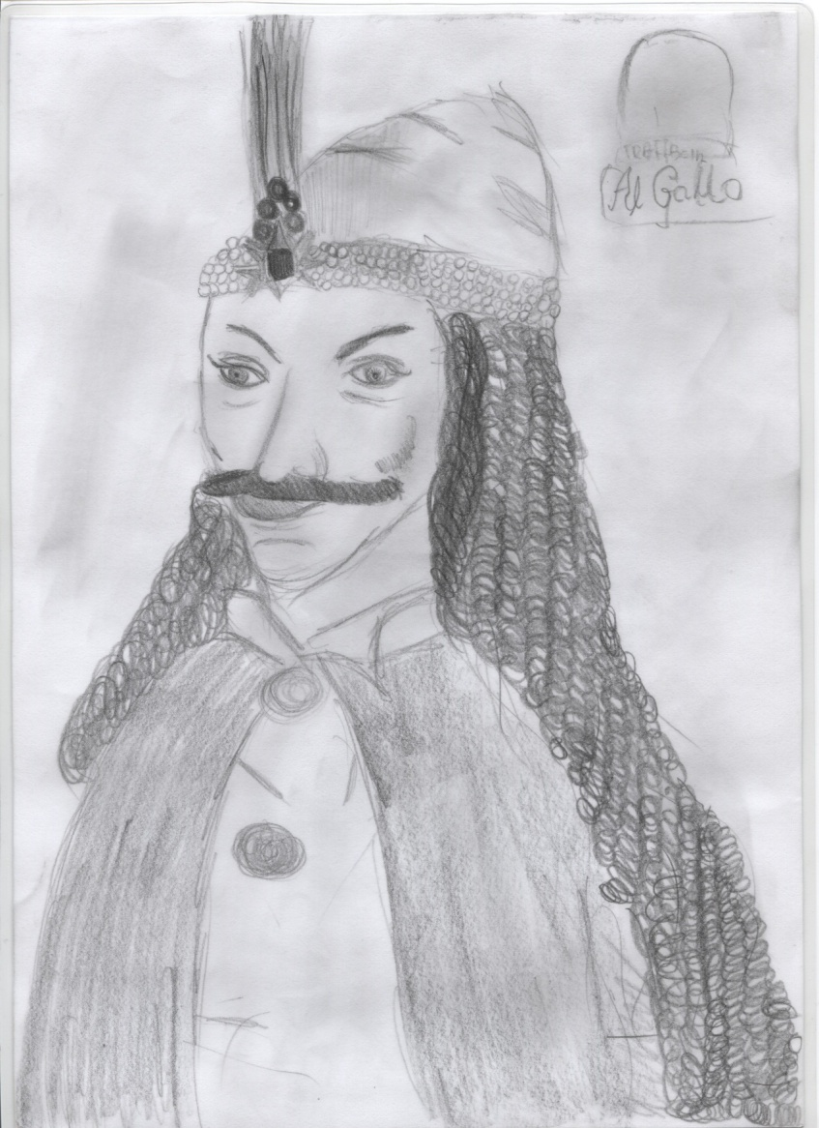
Vlad tepes’s / dracula’s sketches

Slide 19
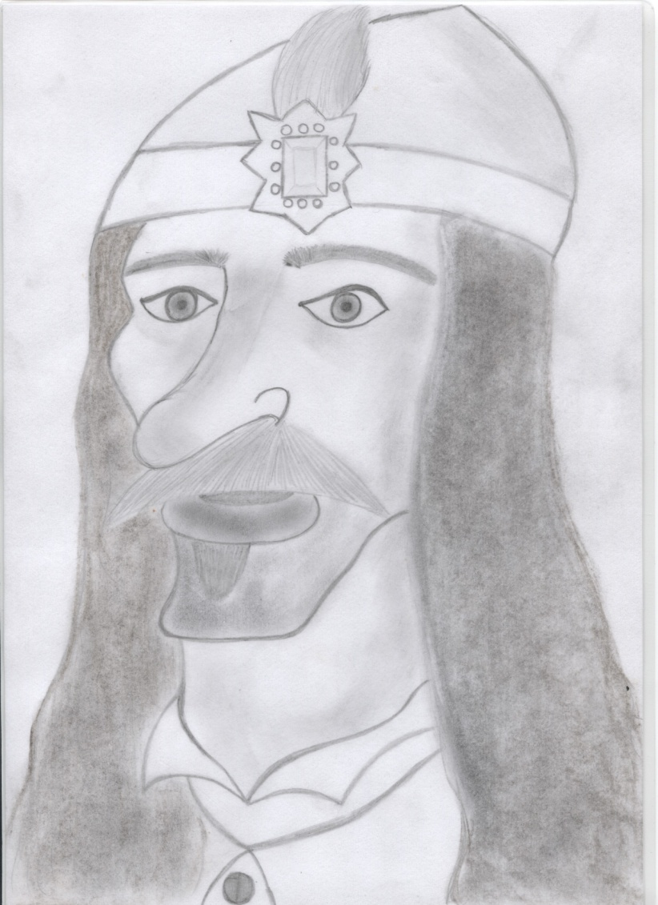
Vlad tepes’s / dracula’s sketches

Slide 20
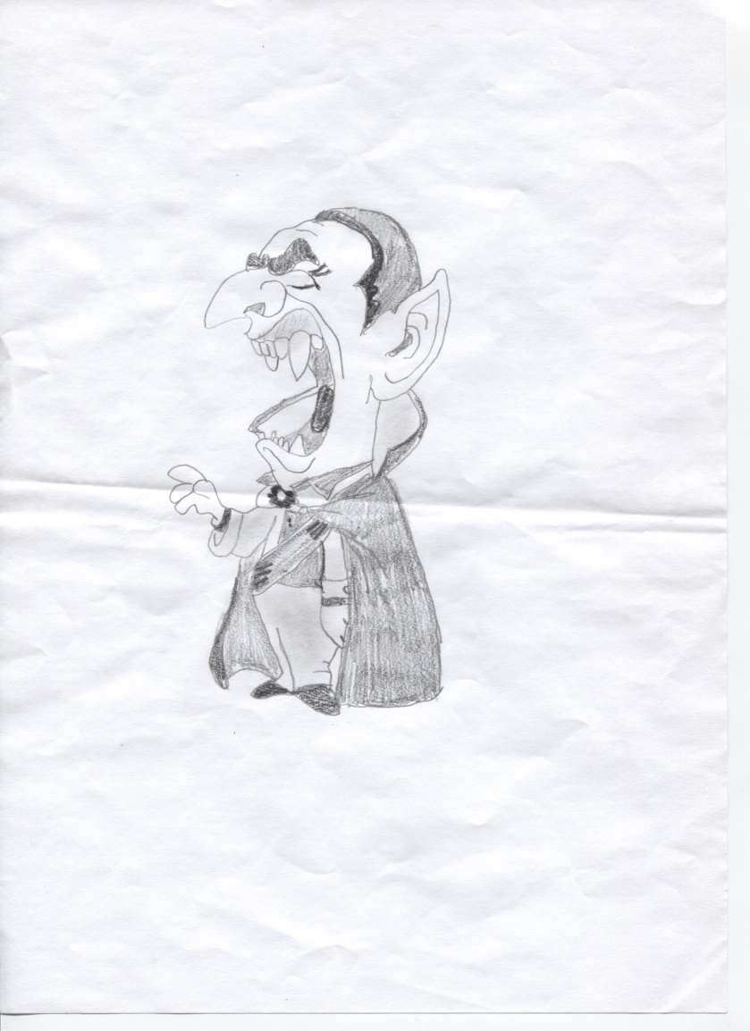
Vlad tepes’s / dracula’s sketches

Slide 21
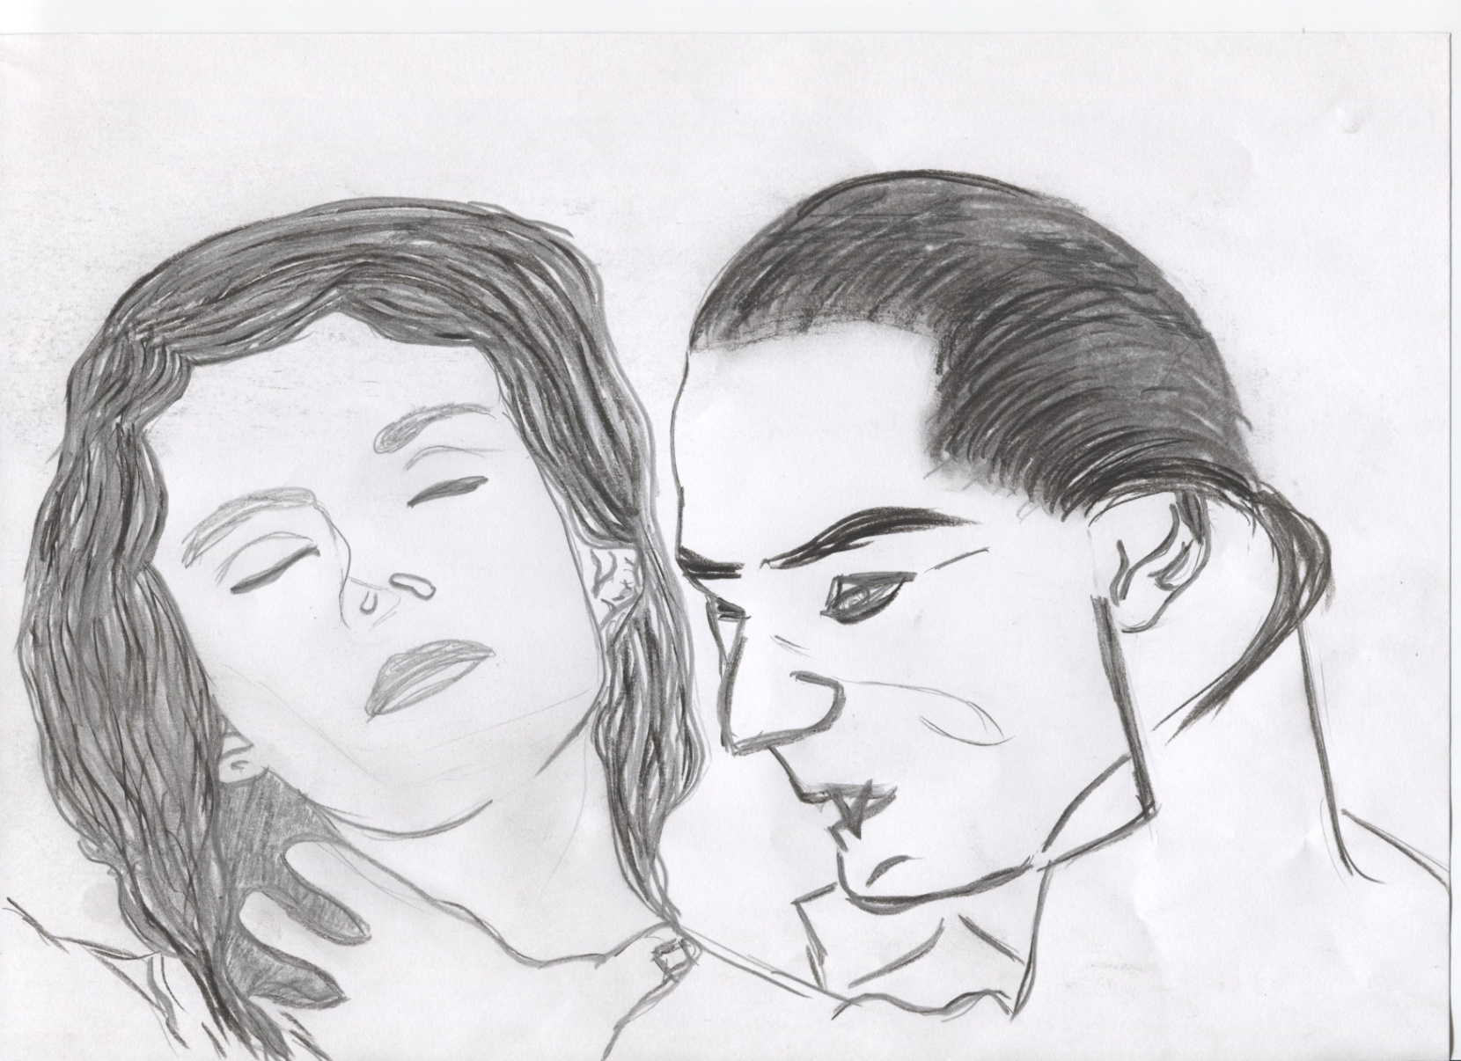
Vlad tepes’s / dracula’s sketches

Slide 22
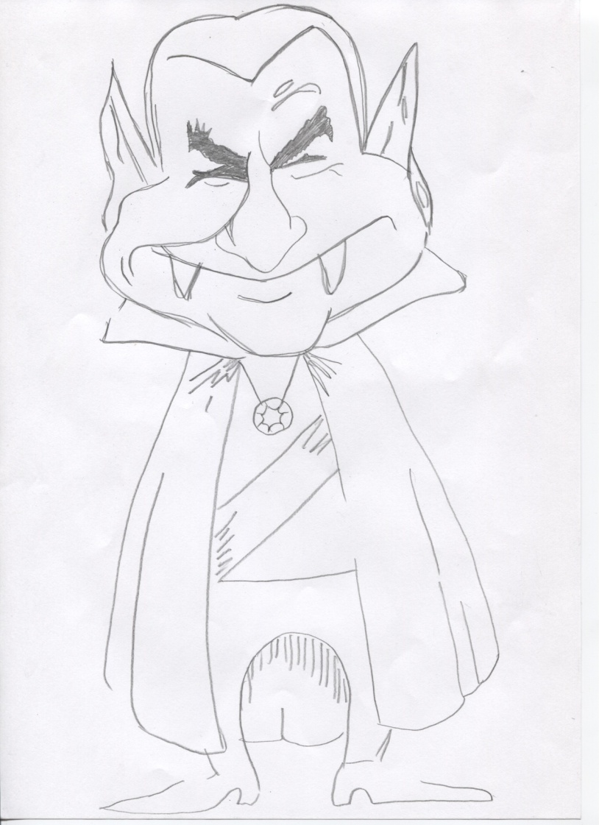
Vlad tepes’s / dracula’s sketches

Slide 23
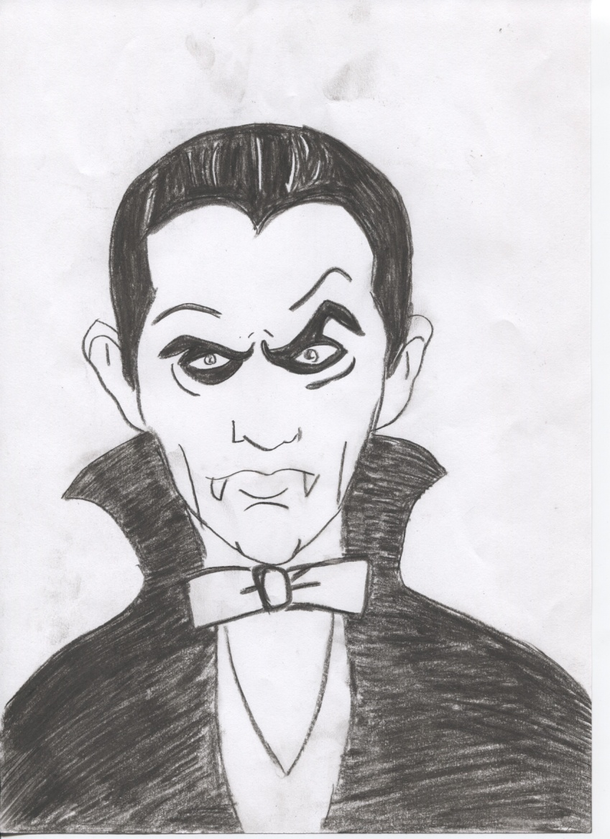
Vlad tepes’s / dracula’s sketches

Slide 24
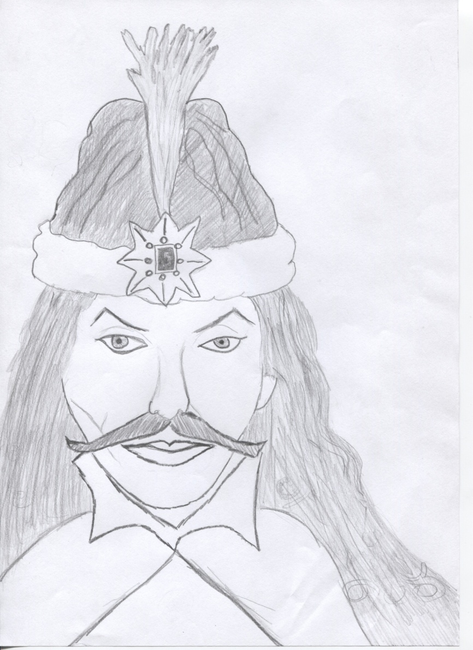
Vlad tepes’s / dracula’s sketches

Slide 25
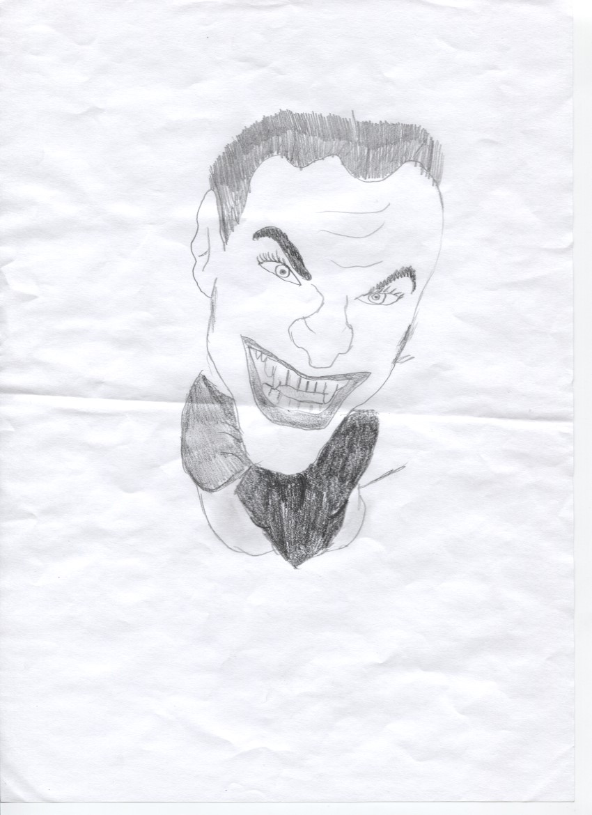
Vlad tepes’s / dracula’s sketches

Slide 26
THANK YOU FOR THE ATTENTION

