Slide 1


LESILE SECONDARY SCHOOL-DOLJ
COMENIUS MULTILATERAL PROJECT
“DEMOCRATIC VALUES AND LINGVISTIC DIVERSITY’’
13-PM-210-DJ-ES
READING PLAN

Slide 2

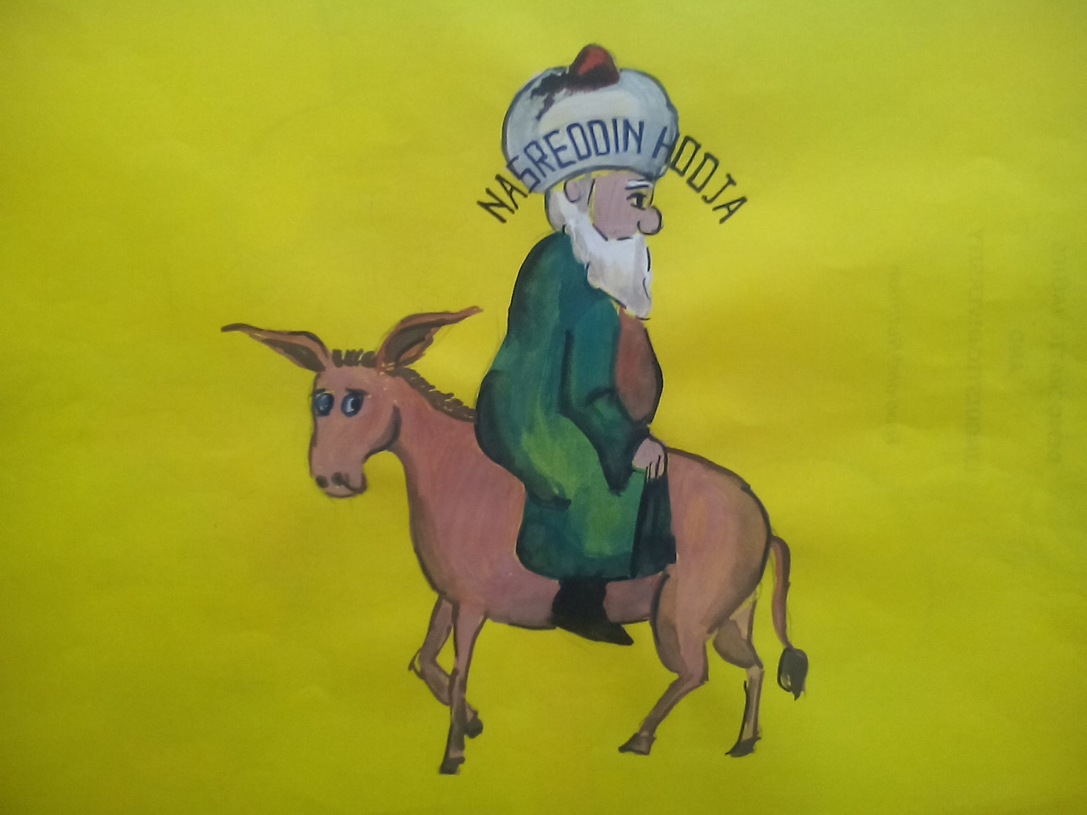
NASREDDIN HODJA STORY CHARACTER

Slide 3
Nasreddin Hodja and universal literature
"In medieval literature of the West there is a character who impresses his readers with his sadness but also with a sense of humor:
Wandering wise.

Slide 4

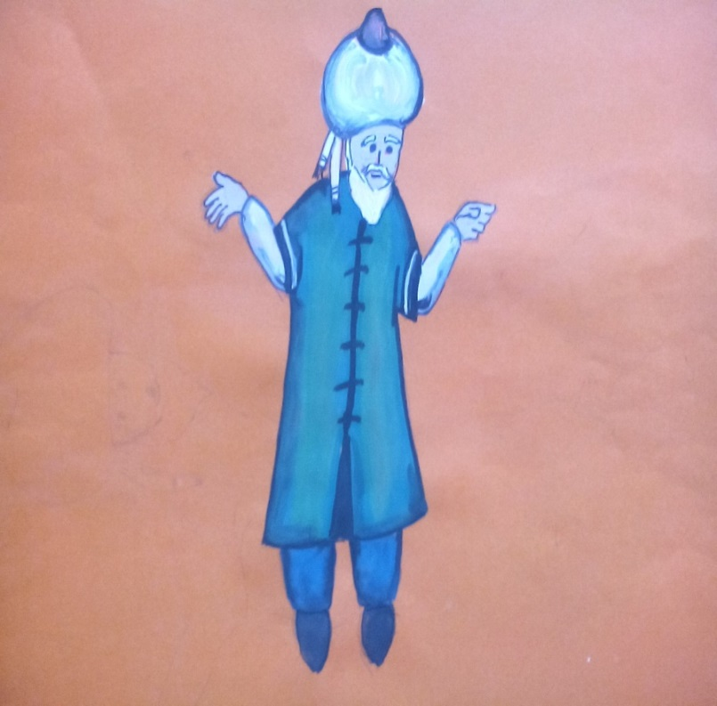
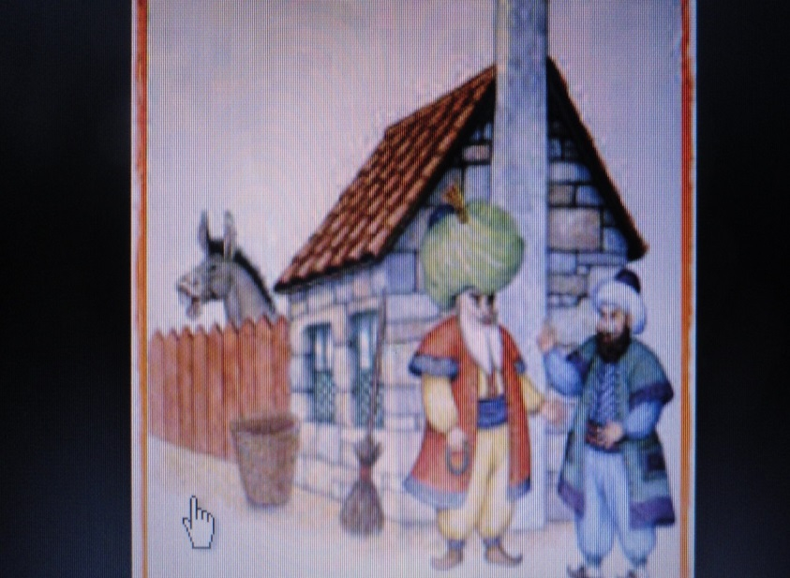
He is known, in the Balkan literature, surviving to the contemporary period, as Nasreddin Hodja.
https://www.google.ro/search?hl=en&site=imghp&tbm=isch&source=hp&biw=1600&bih=610&q=HASTRATIN+HOGEA&oq=HASTRATIN+HOGEA&gs_l=img.3...3002.8144.0.9217.15.9.0.6.0.0.178.893.0j6.6.0.msedr...0...1ac.1.64.img..10.5.752.wVQPtZyUzHo#imgrc=8pNUMV6hr5VWlM%253A%3BLrlrMvX4p2oWGM%3Bhttp%253A%252F%252Fwww.universdecopil.ro%252Fimages%252Fstories%252Feducatie%252Fpovesti%252Fnazdravaniile-lui-nastratin-hogea.png%3Bhttp%253A%252F%252Fwww.universdecopil.ro%252Fnastratin-hogea-si-turbanul.html%3B301%3B295

Slide 5
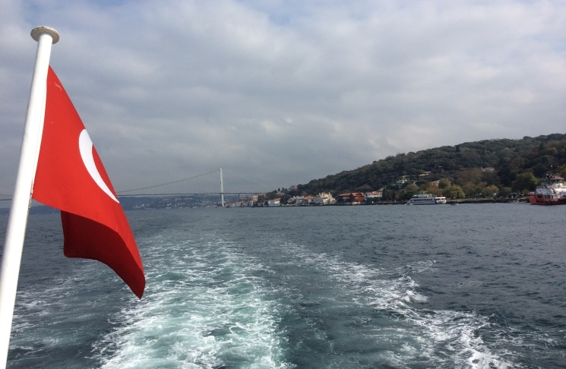
Nasreddin Hodja is a character with oriental origins derived from turkish folklore.
From here it has been spread in all the Balkan’s area, becoming representative for all the region’s literature.
Nasreddin is:
- an emblem of the Balkan mentality,
- a picture of the mixture of tragic, grotesque and satirical prose that characterizes the Balkans. "
Maria Alexe – Nasreddin Hodja
“ A balkanic image of the
wandering wise”

Slide 6

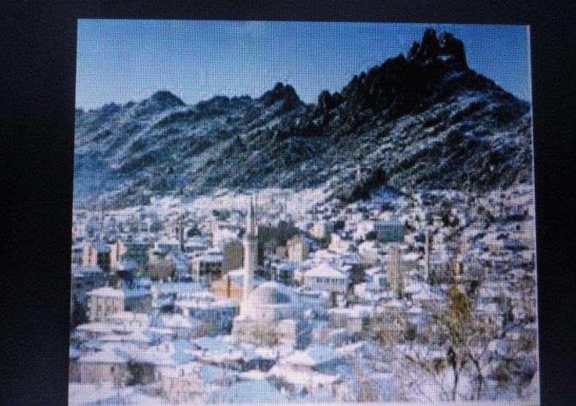
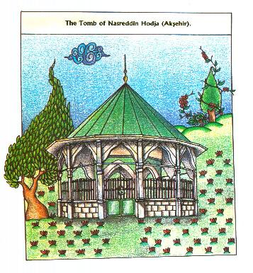
Nasreddin was born in 1208 in Hortu, a village near Sivrihisar town in the western part of Central Anatolia.
The people of this city were well known for their uniqueness and ridicule.
He studied with the great scholars of the time
He was also Kadi, muslim judge, until 1284.
He died in Konya, in the same year.

Slide 7

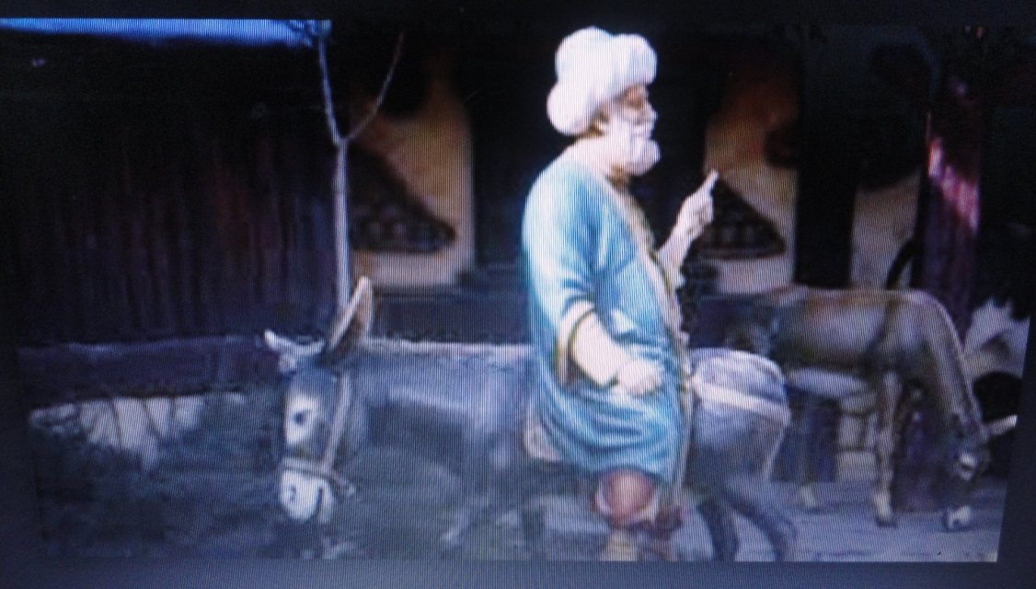
Nasreddin Hodja was a wise philosopher, with a a highly developed sense of humor.
Nasreddin is a satirical figure of the Middle Ages.
He was a scholar and a philosopher who supported common people against the rich people.
He is well known for his funny stories.

Slide 8

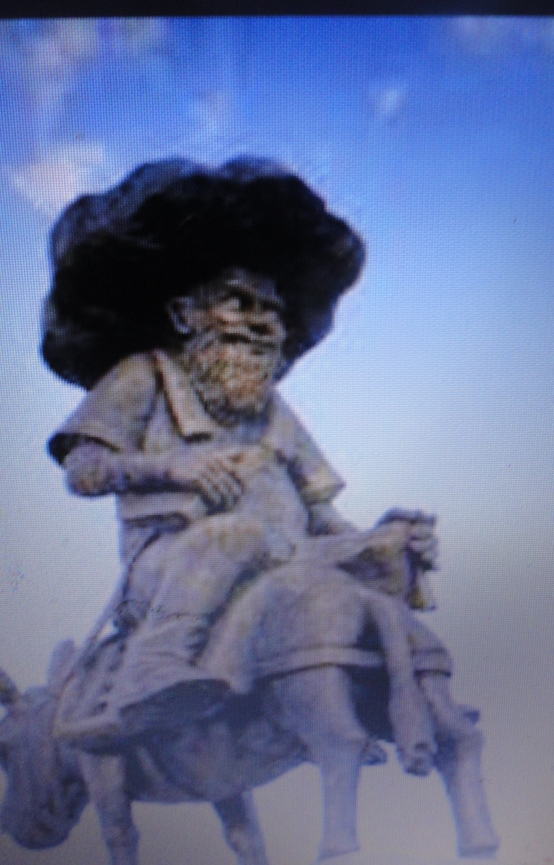
Nasreddin Hodja is a symbol which embodies the desire for learning of the Turkish.
In this way , in his stories, appears also the philosophy of life, the strucuture of the society, the family structure and the turkish culture.

Slide 9
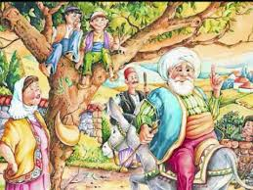
Nasreddin Hodja is a man of one piece.
He shows the people the right way, anounces the good works, leads the people in order to make good actions, making them to avoid the bad actions.
He expressed the problems in a concise way, in an entertaining manner, with a popular style and language, in order to explain the truth and correct the corrupt parts of the society.

Slide 10
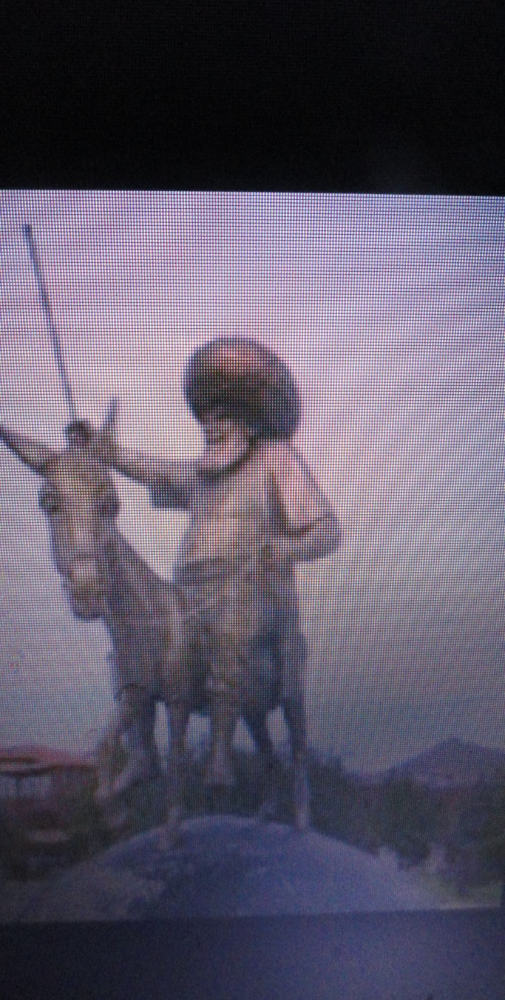
People from Turkey are very familiar with Nasreddin’s jokes and stories.
From their childhoodpeople heard this jokes all the time.
They are part of the turkish’ culture.
It all started with a man called Nasreddin Hodja, who lived in the centre on Turkey.
His jokes were part of his every day life and were accepted by the audience of his time.

Slide 11
The reason why his jokes are still alive?
Turkish citizens and each institution of the turkish society received a critic or a remark from his part.
He didn’t spare with his satire the state, religion culture or customs.
He saw the human element in each aspect of everyday life and used his inteligence to make the world counscious of the true reality.

Slide 12

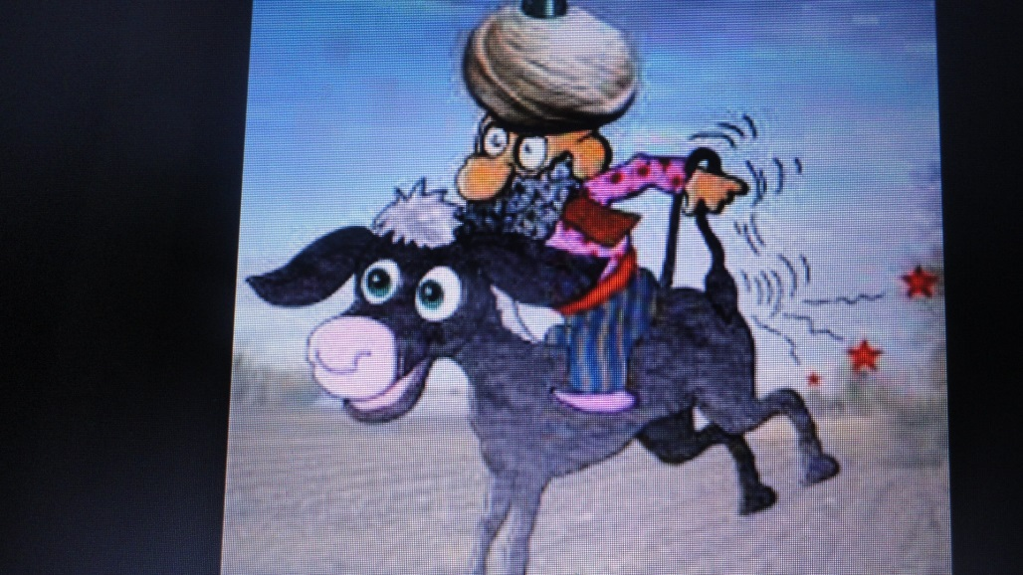
The tradition identifies the literar character with a real person.
Nasreddin is a satirical figure of the Middle Ages.
He was a scholar and a philosopher who supported common people against the rich people.
He is well known for his funny stories.

Slide 13
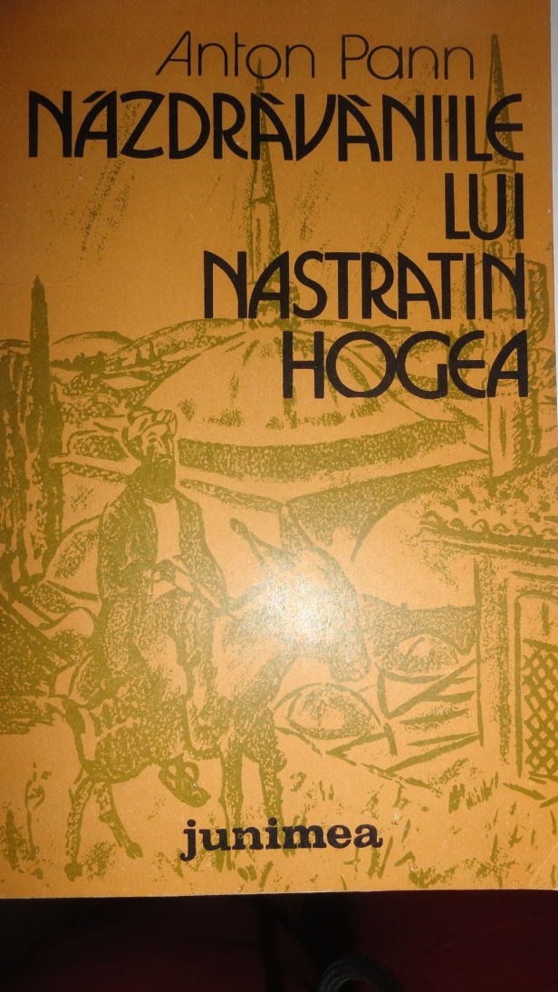
Over generations, new stories were added, others were modified, and the character and his stories were spread to other regions.
The themes of the stories have become part of the folklore of many countries and express the collective imagination of many cultures.

Slide 14
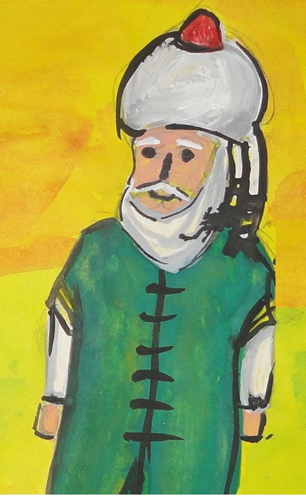
We find Nasreddin, as a literary character, everywhere in the Balkans:
-in it is called Turkish Nasreddin Hoca,
-in Bosnian - Nasrudin Hodzic,
- In Arabic and Persian his name translates as Faith’s Victory,
-in Albanian becomes Nostradin Hoxha or only Nostradini;
-in Azerbaijani culture, we find him as Molla Nəsrəddin
- The Uzbeks know him as Nasriddin Afandi or only Afandi

Slide 15

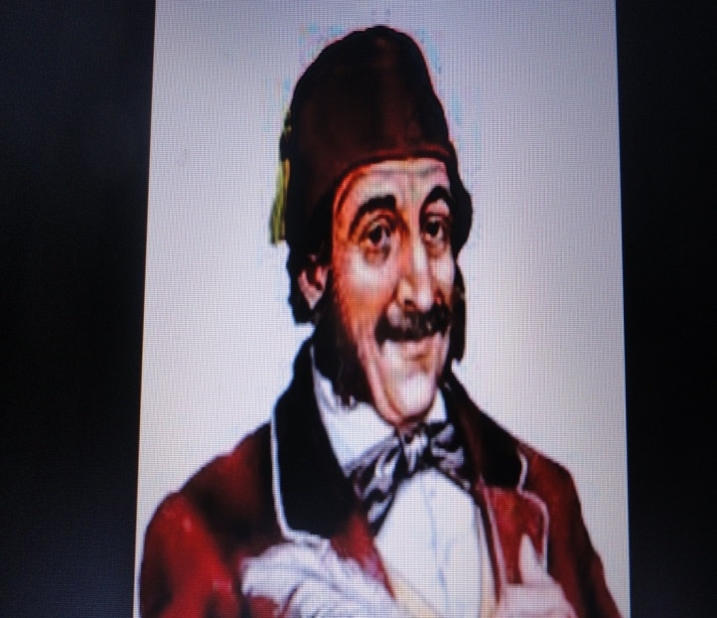
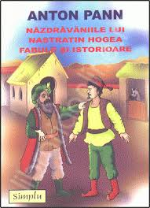
In Romanian literature we find Nasreddin in his folkloric shape at:
Anton Pann in "Năzdrăvăniile lui Nastratin Hogea",
and Ion Barbu in "Nastratin Hogea la Isarlâk"

Slide 16
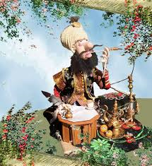
Nowadays, Nasreddin’s stories are spread in many regions and have been translated into many languages
In many regions , Nasreddin is an important figure of culture, and the quotations or references to his works are very present in everyday life.
Nasreddin often appears as a character in a strange humor folklore of many cultures: Albanian, Arabic, Azeri, Bengali, Bosnian, Bulgarian, Greek, Hindu, Italian, Persian, Romanian, Serbian, Turkish and Urdu.
(http://ro.wikipedia.org/wiki/Nastratin_Hogea

Slide 17

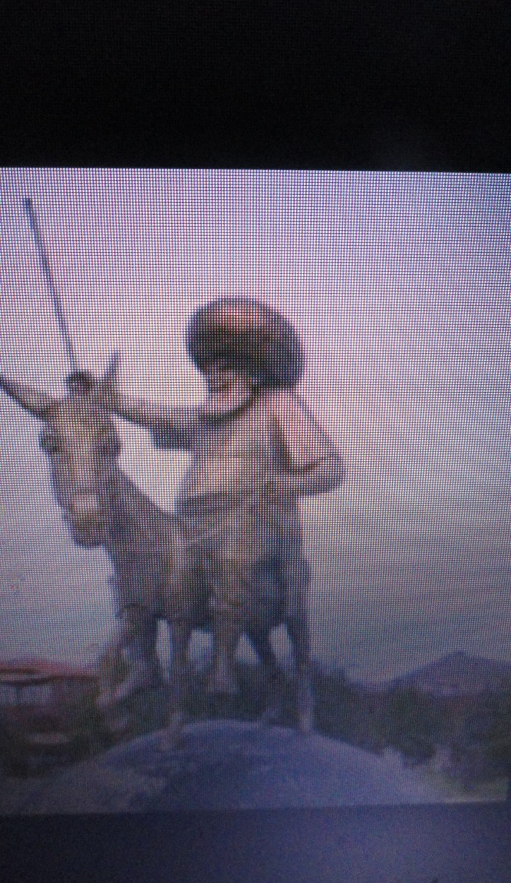
He was a man of great humor,
was very intelligent and
had an answer to almost all problems and dilemmas of his time.
Even today, about 600 years after he lived and died, people in Turkey still laugh
and think about his tricks, common sense, anecdotes and ingenuity.

Slide 18

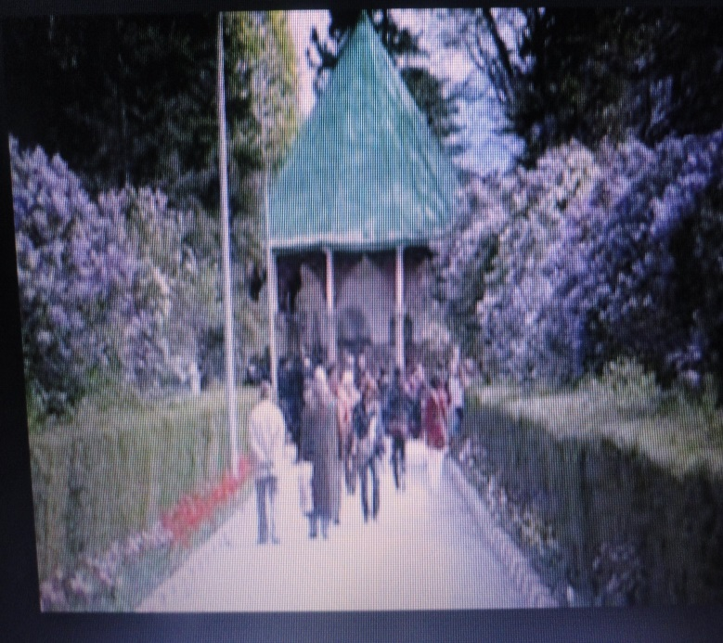
1996-1997 was declared International Nasreddin Year by UNESCO.
Between 5 and 10 July takes place the International Festival "Nasreddin" which takes place every year in Akşehir - Turkey, where his grave is.

Slide 19


Turkish artists have used Nasreddin Hodja in the plays, music, movies, cartoons and paintings

Slide 20

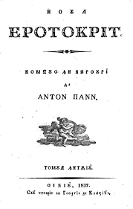
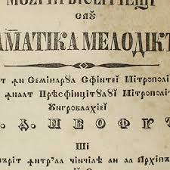
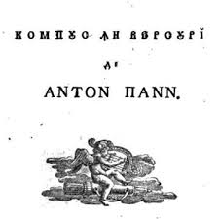
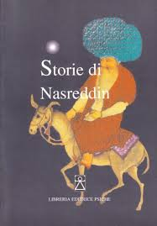
His stories reflect not only his life as a native of Anatolia but also his time and life of the Turkish people who lived at that time in Anatolia.
His jokes were translated into several languages.
His jokes and his stories are told today by people in many countries.

Slide 21
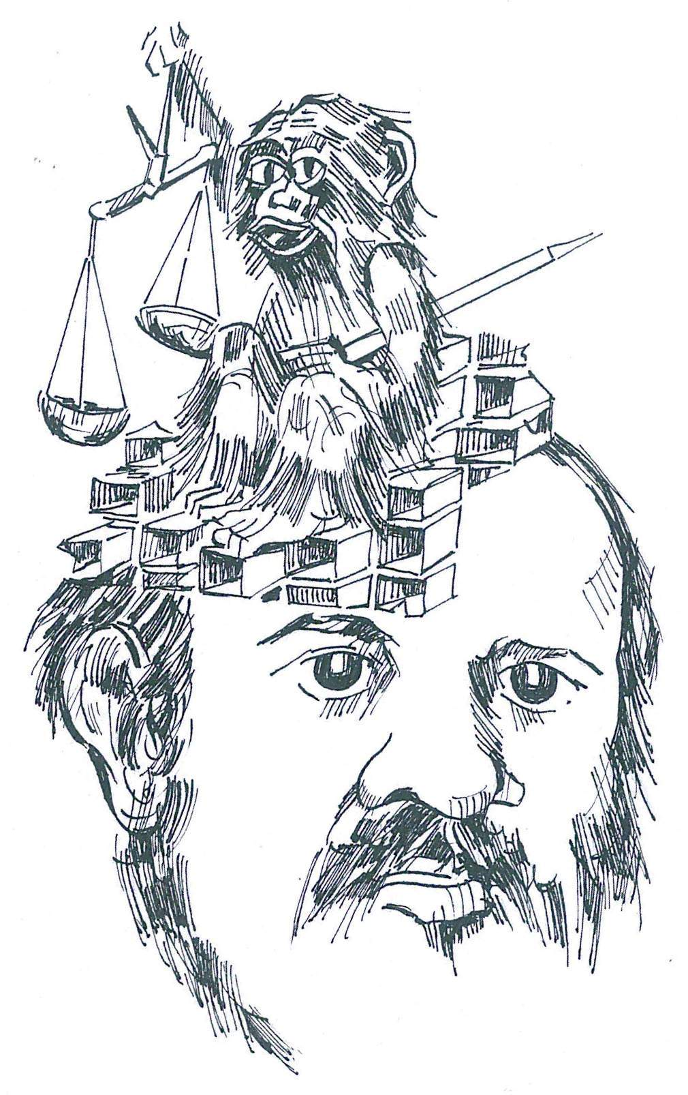
All these stories are attributed to Nasreddin for hundreds of years, but have not gone all from him.
Most of them are the product of collective humor, not only the Turks, but also other people in the world.

Slide 22

GLOSAR/GLOSSARY
NASTRATIN HOGEA
NASREDDIN
13-M-210-DJ-ES

Slide 23
Pe Nastratin Hogea, ca personaj literar, îl găsim peste tot în Balcani About Nasreddin, as a literary character, we find everywhere in the Balkans
LIMBA Language | NASTRATIN HOGEA | Povestea lui NastratinHogea Personaj de poveste
ENGLEZA English | Nasreddin | The story of Nasreddin-Fairytale charactere
ROMANA Romana | Nastratin Hogea | Povestea lui NastratinHogea Personaj de poveste

Slide 24
ROMANA Romana | Nastratin Hogea | Povestea lui NastratinHogea Personaj de poveste
TURCA Turkish | Nasreddin Hoca, | Nasreddin Hoca hikaye, karakter of hikayesi.
BOSNIACA Bosnian | Nasrudin Hodža | Nasrudin Hodža priču, lik priča.
PERSANA Persian | ملا نصرالدین, Numele se traduce Victoria Credinţei | تاریخچه از شخصیت های داستان نصرالدین
ARABA Arabic | جحا Joha | تاريخ شخصيات القصة نصر الدين

Slide 25
ALBANEZA Albaneza | Nostradin Hoxha sau Nostradini | Historia e karaktereve Historia Nostradini, tregim personazhi.
AZERA Azeri | Molla Nəsrəddin | Nəsrəddin hekayə simvol tarixi
UZBEZA Uzbec | Nasriddin Afandi sau numai Afandi | Nasriddin hikoya belgilar tarixi
SPANIOLA Spanish | Nasreddin | La historia de Nasreddin

Slide 26
ITALIANA Italian | Nasreddin | La storia di Nasreddin personaggio di racconto.
POLONEZA Polish | Nasreddin Hodza | Nusreddin Opowieść, bohater historia. Historia Nasreddin- Opowiesc o Nasreddinie
BULGARA Bulgarian | Настрадин | Историята на Настрадин Ходжа

Slide 27
Variante de nume Numele lui Nastratin mai este scris și: His name Nasreddin is also written: | Nasreddin, Nasrudin, Nasr ud-Din, Nasredin, Naseeruddin, Nasruddin, Nasr Eddin, Nastradhin, | Nasreddine, Nusrettin, Nasrettin, Nostradin sau Nastradin (lit.: Nasr =„Victorie”) a Deen =„Religiei”).

Slide 30
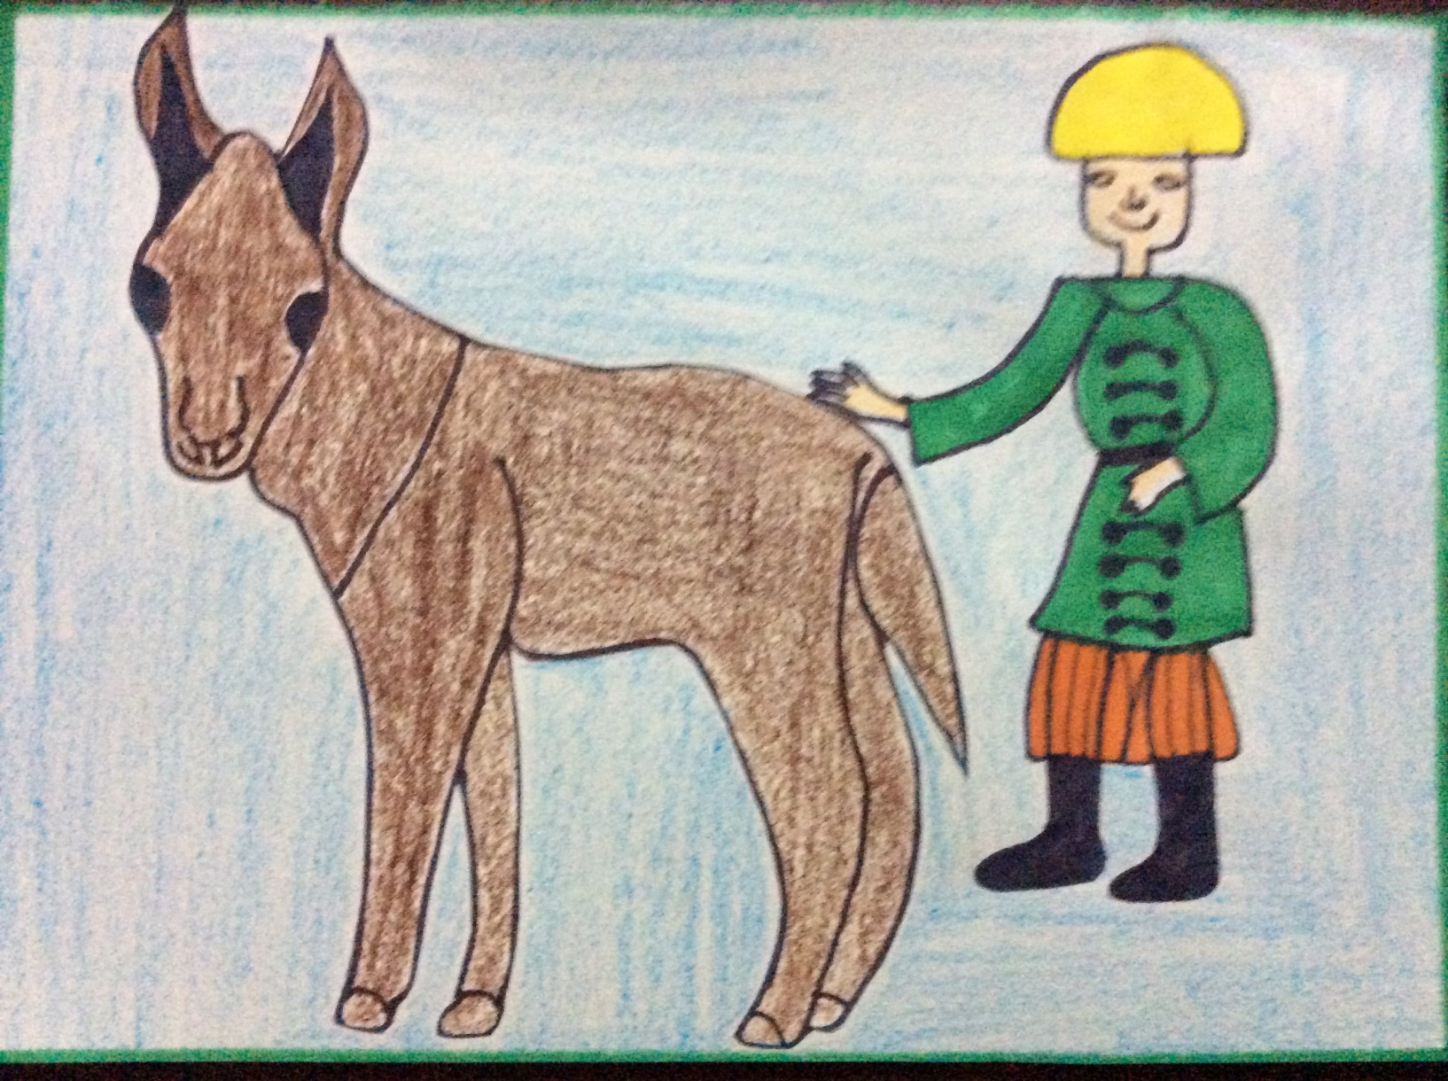

Slide 31
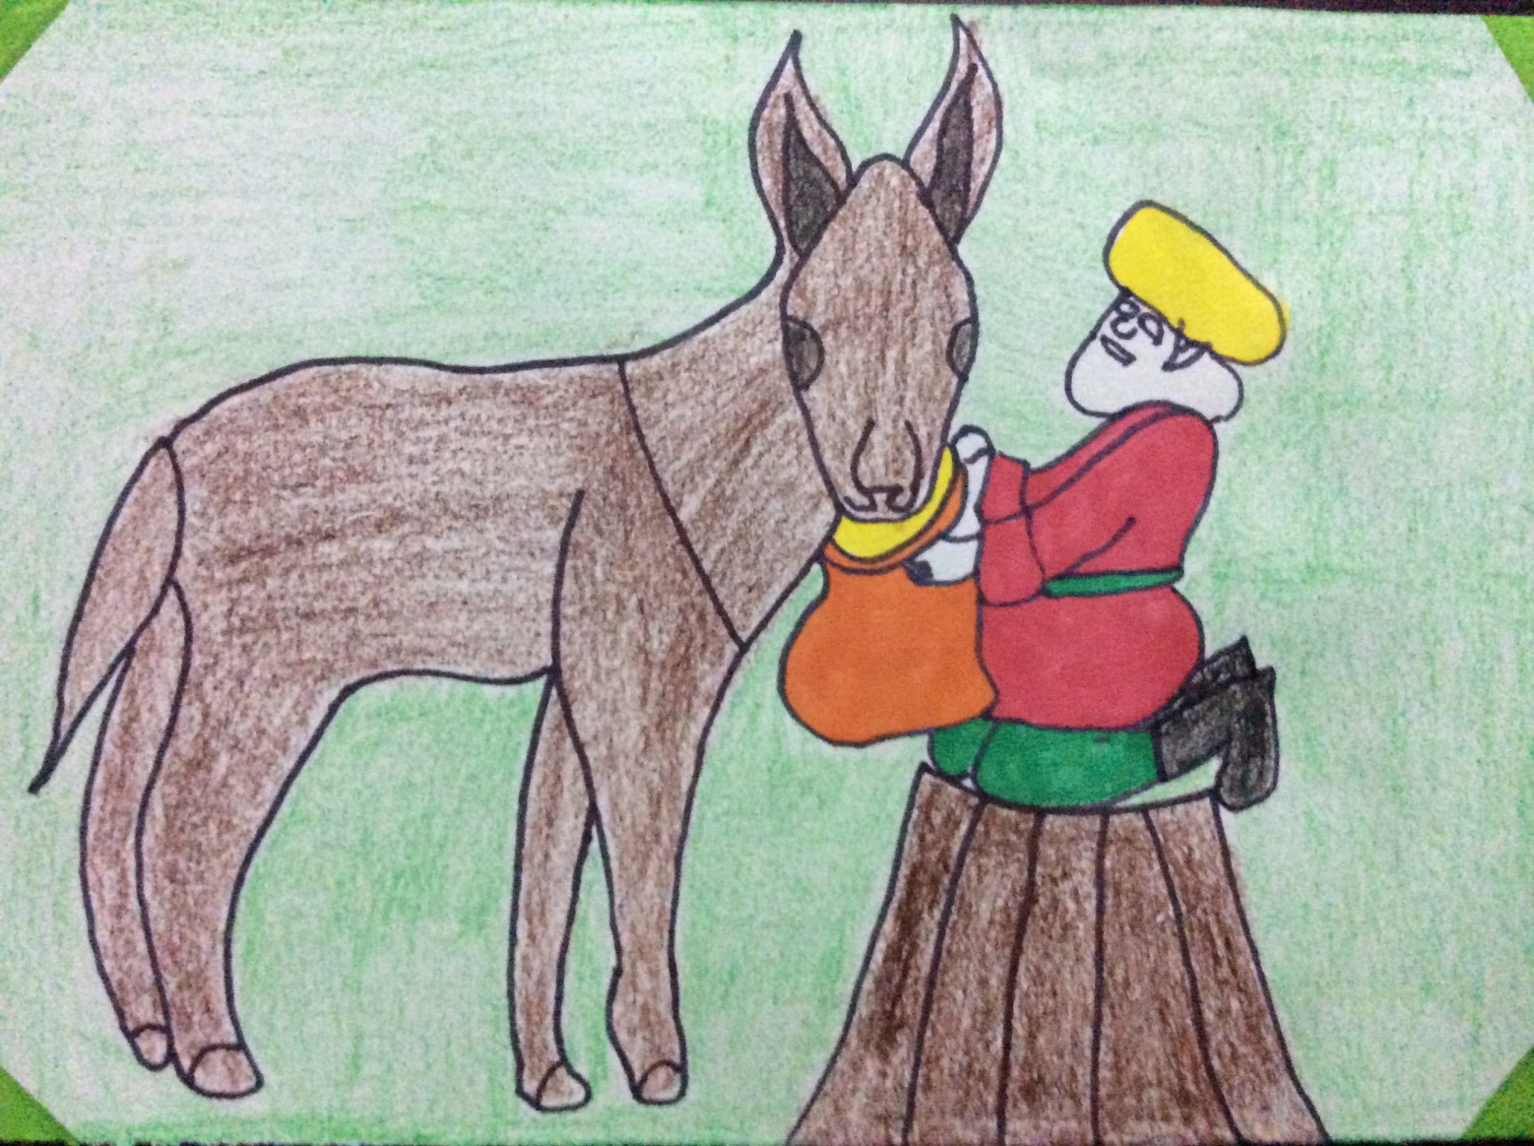

Slide 32
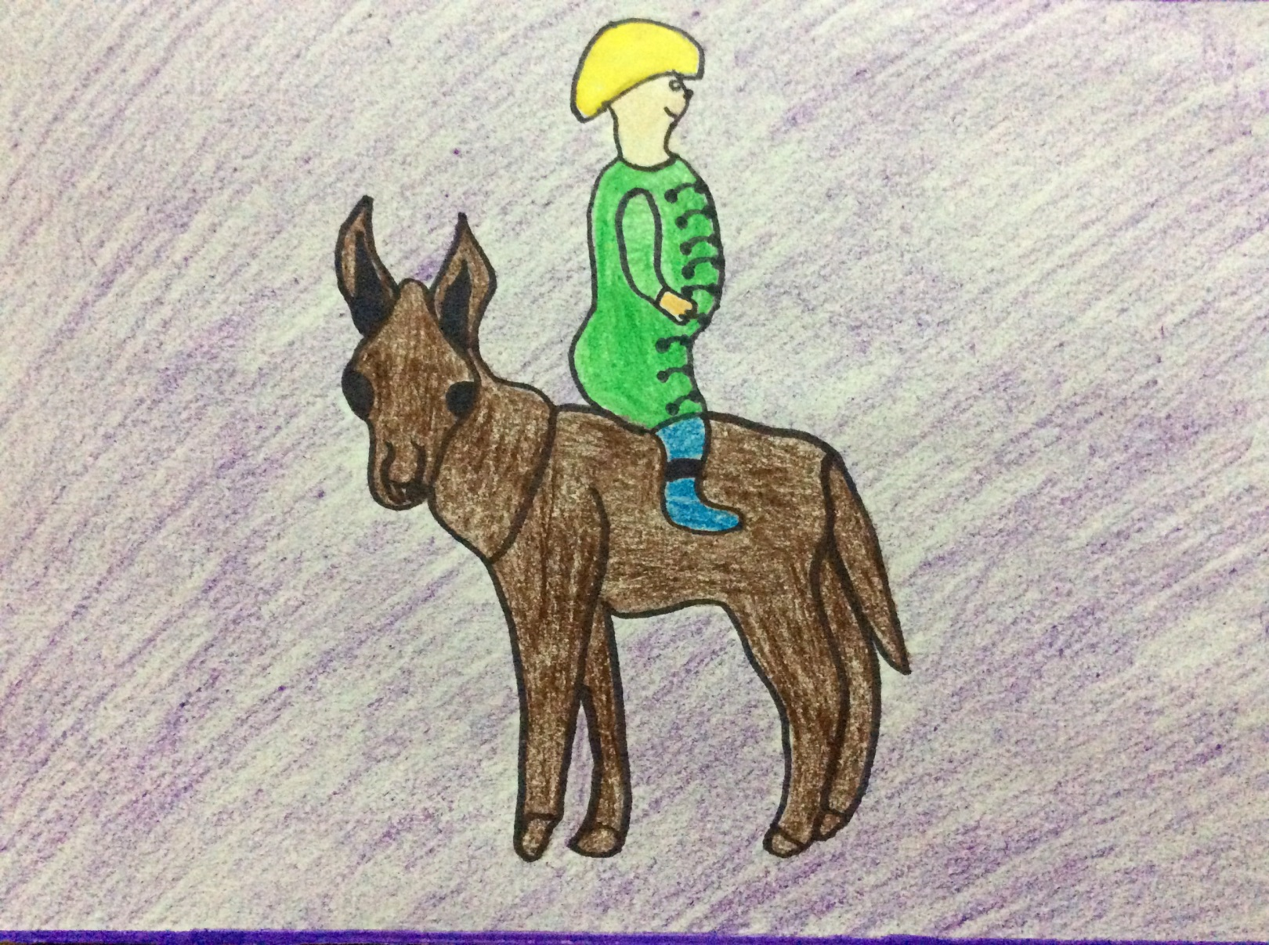

Slide 34
Filmmakers: Comenius Team
Adriana GHERGHE-manager
Flori MITRA
Marina TUȚULEASA
Roxana DONDONEATA
Mădălina PRODAN

Slide 35

Nasreddin
and
Comenius team
Thank you for your attention

