Slide 1


SECONDARY
SCHOOL
LESILE
DOLJ
ROMANIA
COMENIUS
MULTILATERAL PROJECT
“Democratic values
​​and
linguistic diversity”
13-PM-210-DJ-ES

Slide 2
BULGARIA MOBILITY-SOFIA
12-14 MAY 2014
SPORT IN ROMANIA
SPORTS COMPETITIONS

Slide 3
SECONDARY
SCHOOL
LESILE
DOLJ
ROMANIA
COMENIUS
MULTILATERAL PROJECT
“Democratic values
​​and
linguistic diversity”
13-PM-210-DJ-ES

Slide 4
SECONDARY
SCHOOL
LESILE
DOLJ
ROMANIA
COMENIUS
MULTILATERAL PROJECT
“Democratic values
​​and
linguistic diversity”
13-PM-210-DJ-ES

Slide 5


SPORT IN ROMANIA
ROMANIAN HISTORY OF SPORT
ROMANIAN SPORTS
WORLD ATHLETES
SPORT PERFORMANCE IN ROMANIA
SPORT PERFORMANCE AT LESILE-DOLJ
SPORT RELATED ACTIVITIES AT SCHOOL

Slide 6
SPORT IN ROMANIA
The first sporting clubs in Romania were established in the mid nineteenth century
One of the first companies was named "Company of placing the sign", established during the reign of Alexandru Ioan Cuza.
In the early years of the twentieth century sports like boxing and cycling have expanded while team games a lot later.

Slide 7
The first football meci was played in Timisoara, June 25th, 1899
the first rugby club was established in Bucharest in 1910
the Sports Federation was established in 1912 at Bucharest,
In 1914 the Romanian Olympic Committee was established
in 1923 was founded the first institution of higher education in sport: the "National Institute of Physical Education"

Slide 8
Romanian sports
OINA
Oina is a Romanian traditional sport.Oina was first mentioned during the rule of Vlaicu Voda in 1364, when it spread all acrossWallachia. Its origins are disputed, theories ranging from a shepherd game to a war game
The game of oina is reminiscent of an old Daco-Roman occupation, shepherding.
the verb means to move the sheep from the mountains to the plains, a phenomenon called transhumance.

Slide 9
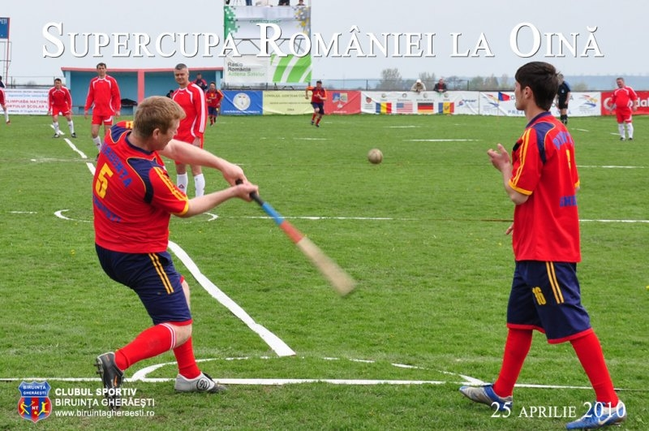
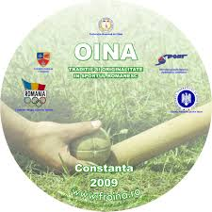
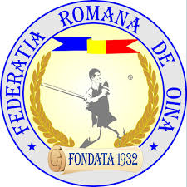
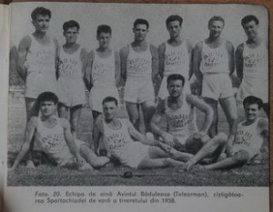
The first edition of the Romanian Cup was held in 1955 in Iasi, and was won by Ştiinţa (Universitatea) Bucureşti, one of the greatest teams .
The main competitions are:
The National Championship
The Romanian Cup
The Romanian Supercup
The National Junior Championship

Slide 10
Football
The national football team has its first meci on 8th June 1922 atBelgrad, against Yugoslavia,
score :2-1 for Romania
On May 20, 1923 the Committee of the Football Federation of Societies, is admitted as a member of FIFA
as a member of FIFA, Romania participates in the Olympic Football Tournament at the 1924 Olympics held in Paris.
Romanian Football Federation is a founding member of UEFA in 1954..

Slide 11
At international level, the Romanian football team participated at 7 World Cups.
The most famous football club is Steaua Bucharest Romania, which in 1986 was the first team from Eastern Europe and first from Romania to win the European Cup.
The leader of the golden generation of Romanian football is George Hagi.Other famous Romanian football players are Adrian Mutu and Cristian Chivu .

Slide 12
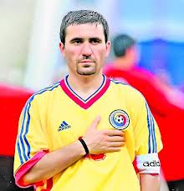
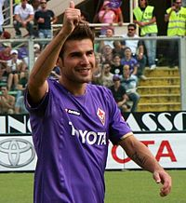
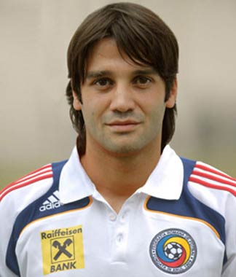
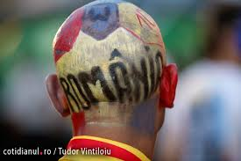
GHEORGHE HAGI ,ADRIAN MUTU
CRISTI CHIVU

Slide 13
Other sports and olimpic games
Romania's first Olympic participation was in 1900 when we participated with one sportsman -The Romanian delegation was present in all editions of the Olympic Games since 1924
Romania won 292 medals at Summer Olympics, from the first edition, Paris, 1924 to 2008 Beijing edition

Slide 14
A silver medal at the 1936 Olympics in Berlin.
First world championship titles were won in 1934 and 1936
Romanian boxing obtained first European title in 1930 by Lucian Popescu
Sport Performance:
Iosif Sîrbu and Iolanda Balaș. athletics, canoeing - Ivan Patzaichin
and rowing-Elisabeta Lipa.

Slide 15
GYMNASTICS
Romanian gymnastics has had a large number of successes for which Romania has become known throughout the world.
Nadia Comaneci by its resounding performance is recorded in the history of sport as an expression of perfection and has been recognized over the years as a sports representative of the twentieth century.

Slide 16
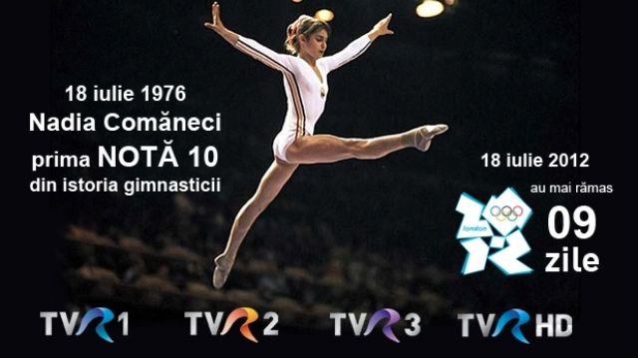
NADIA COMĂNECI
On July 18, 1976, a girl of 14 who amazed the sports world with unmatched performance:"absolute" 10 at the Summer Olympics in Montreal.
The display was not scheduled to show grade 10, so that on the screen appeared 1.00. Nadia Comăneci got at these Olimpic Games 7 times 10,won 3 gold medals, ,
A silver and a bronze.

Slide 17
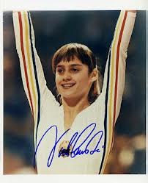
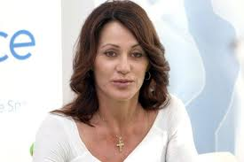
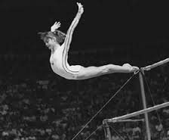
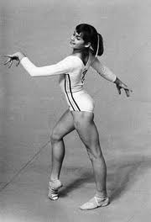
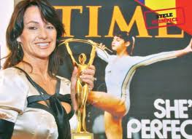
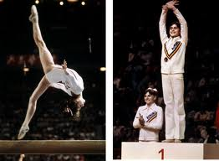
NADIA COMĂNECI

Slide 18
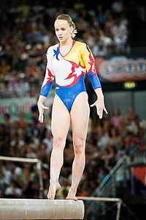
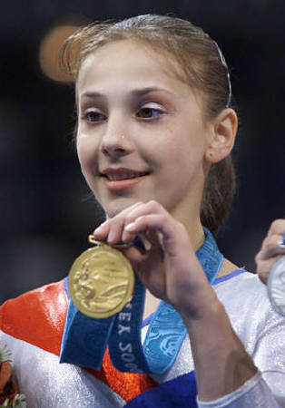
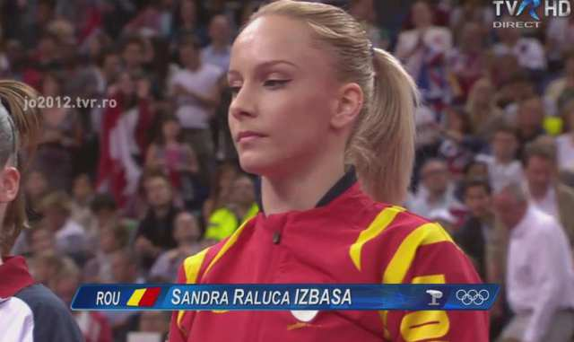
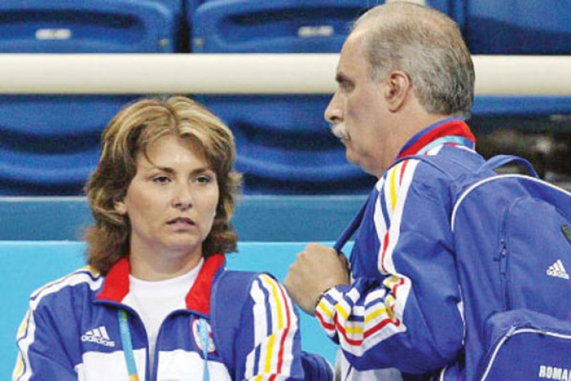
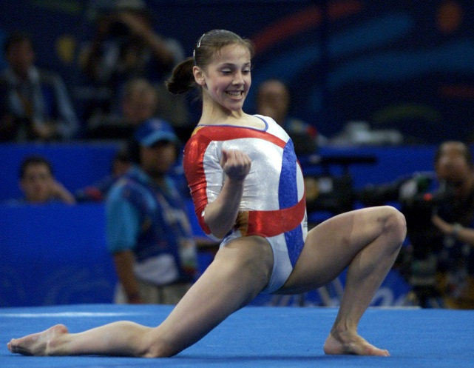
SANDRA IZBASA,ANDREEA RADUCAN
COACH:MARIANA BITANG si OCTAVIAN BELU

Slide 19
SECONDARY
SCHOOL
LESILE
DOLJ
ROMANIA
COMENIUS
MULTILATERAL PROJECT
“Democratic values
​​and
linguistic diversity”
13-PM-210-DJ-ES

Slide 20
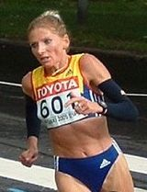
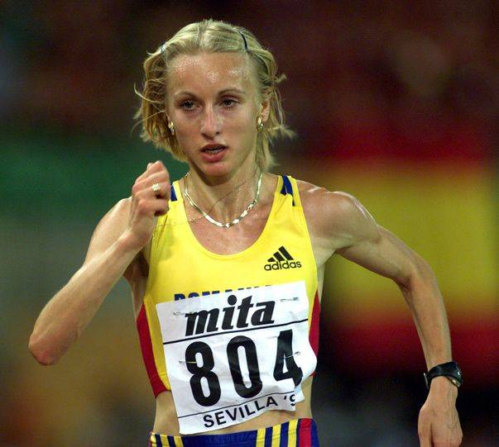
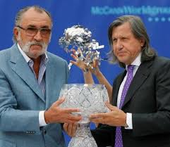
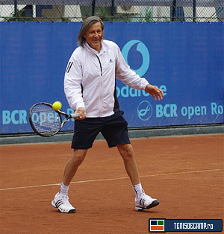
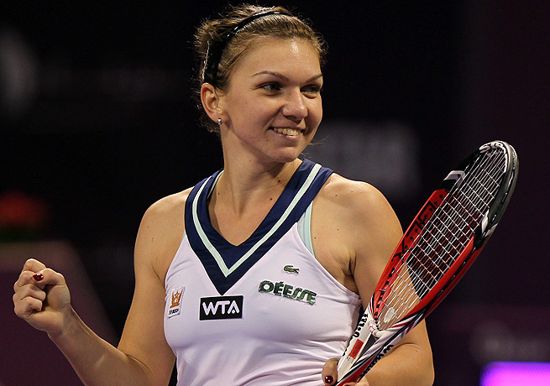
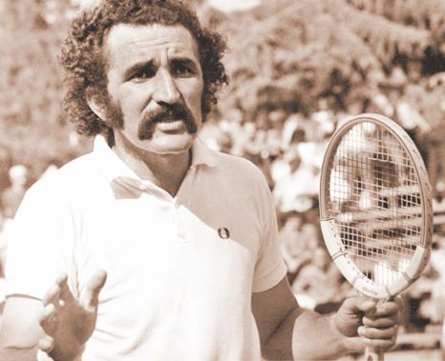
HIGH PERFORMANCE ATHLETES IN ROMANIA
Constantina Dișa-Tomescu,Gabriela Szabo-athletism
Ion Țiriac, Ilie Năstase și Simona Halep– tennis

Slide 21
SECONDARY
SCHOOL
LESILE
DOLJ
ROMANIA
COMENIUS
MULTILATERAL PROJECT
“Democratic values
​​and
linguistic diversity”
13-PM-210-DJ-ES

Slide 22
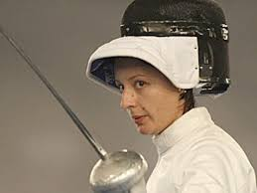
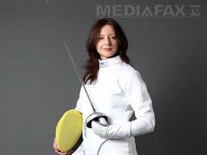
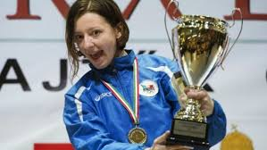
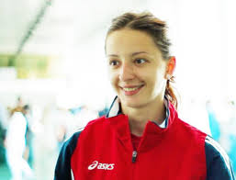
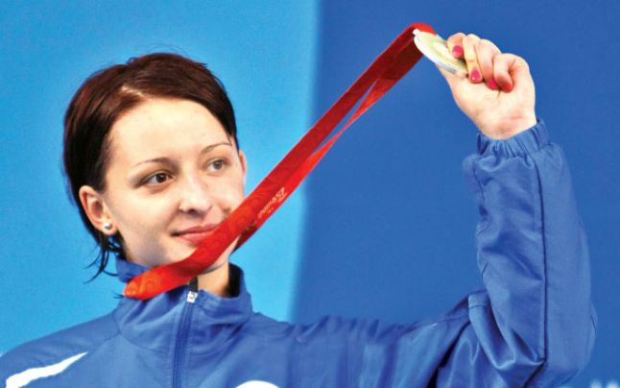
FENCING
ANA MARIA BRÂNZĂ –SILVER AT OLYMPIC GAMES AT Beijing.

Slide 23
SECONDARY
SCHOOL
LESILE
DOLJ
ROMANIA
COMENIUS
MULTILATERAL PROJECT
“Democratic values
​​and
linguistic diversity”
13-PM-210-DJ-ES

Slide 24


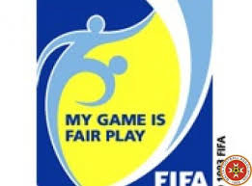
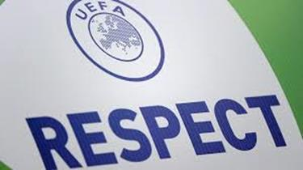
SPORTIVE COMPETITIONS NEED TO BE
FAIR-PLAY
FAIR-PLAY - Respect for the rules or equal treatment of all concerned.

Slide 25
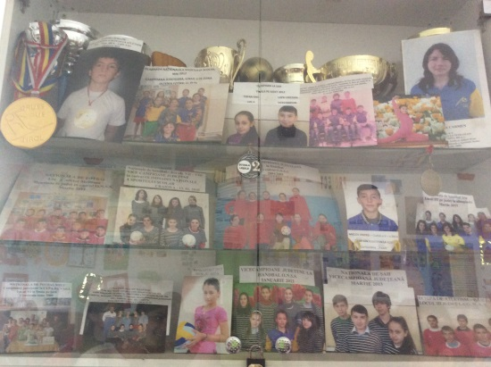
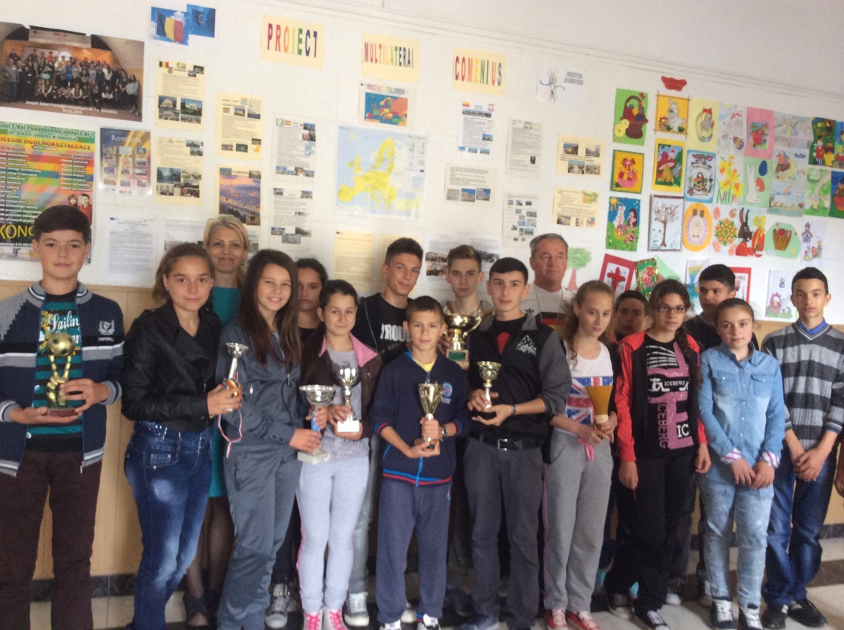
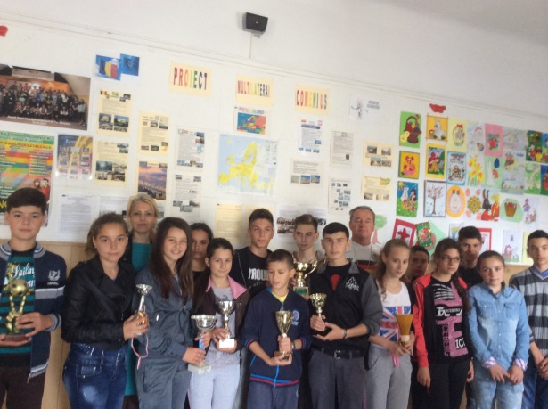
Our students at LEȘILE –DOLJ SCHOOL

Slide 26
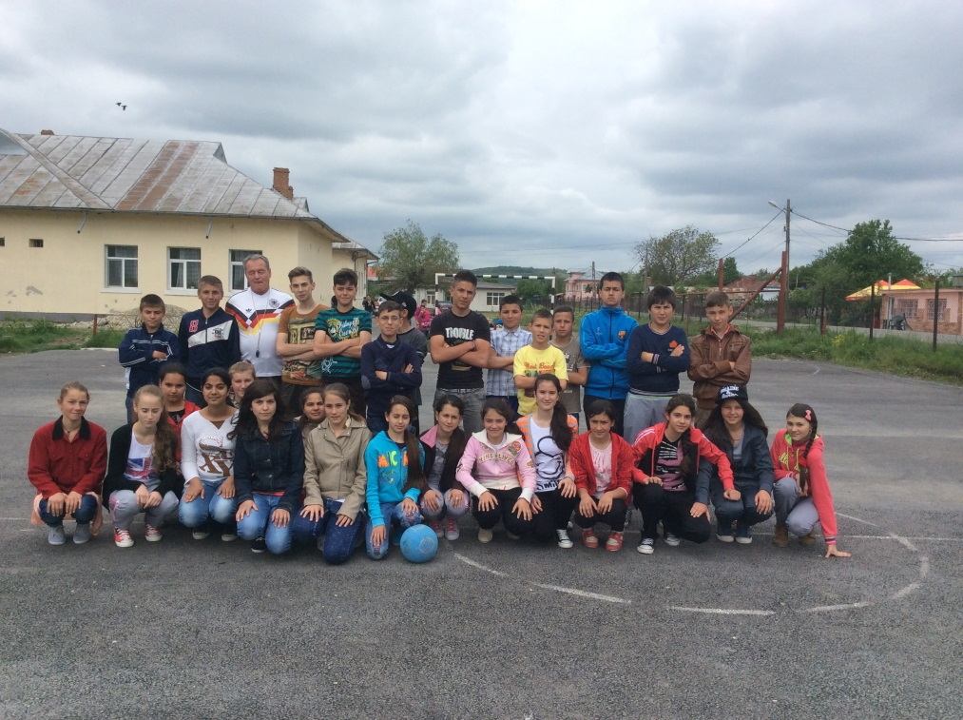
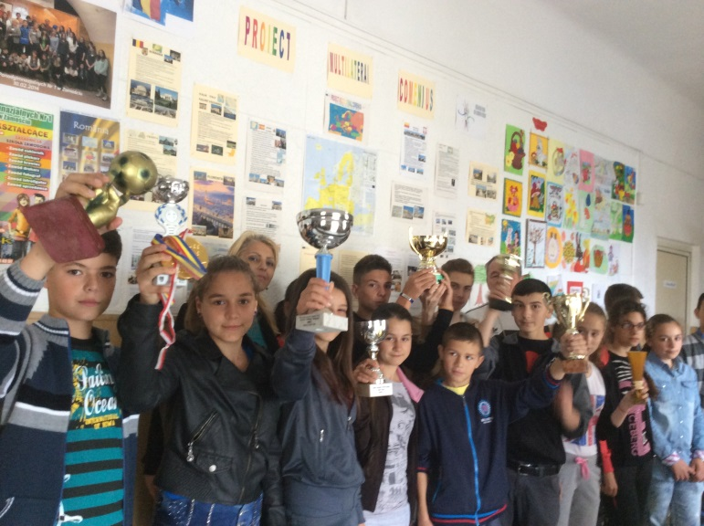
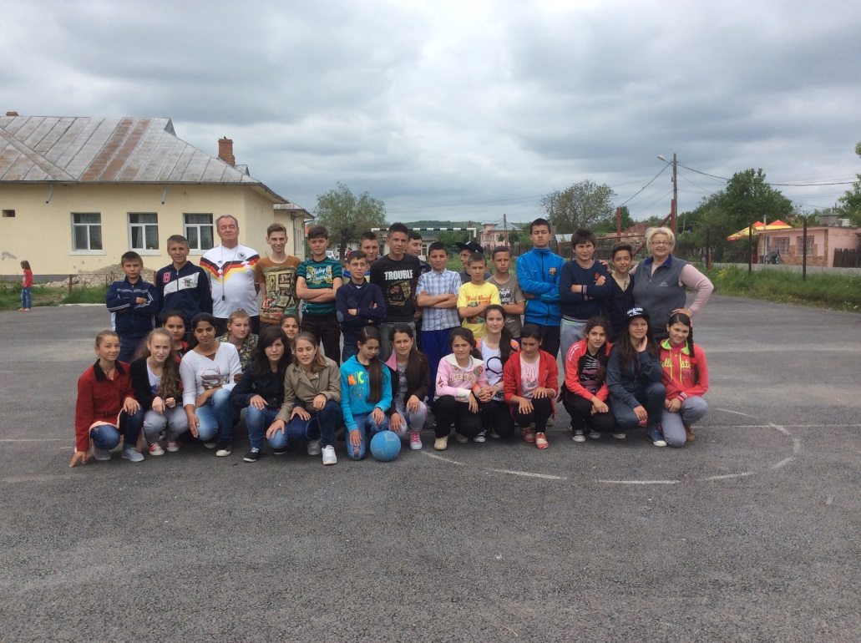
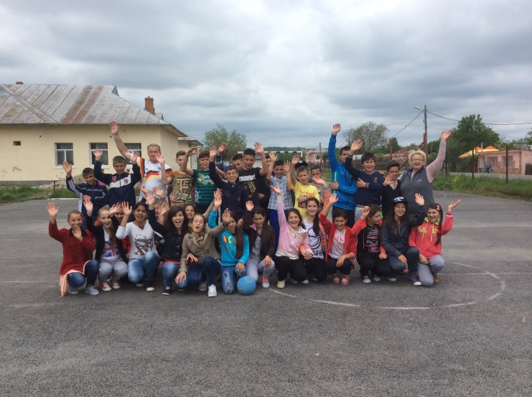

Slide 27
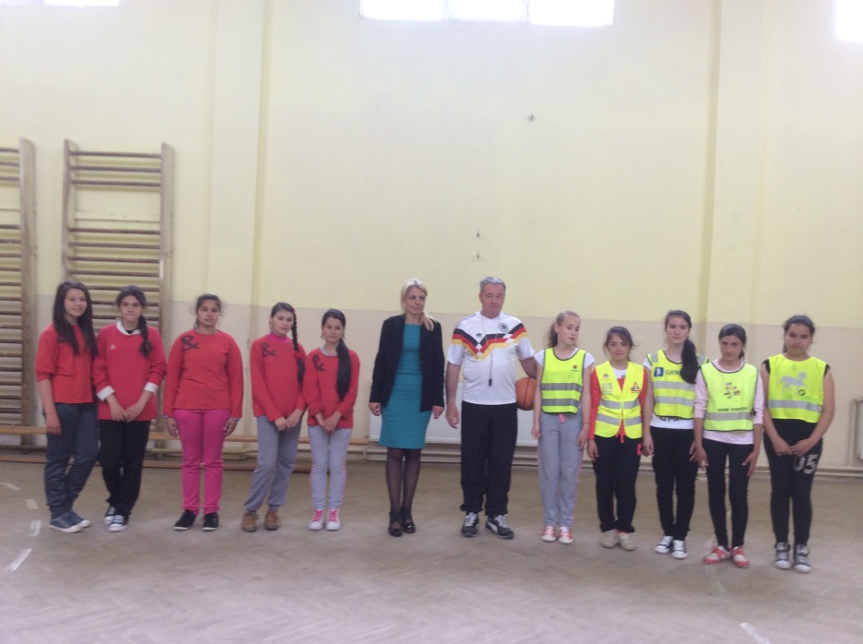
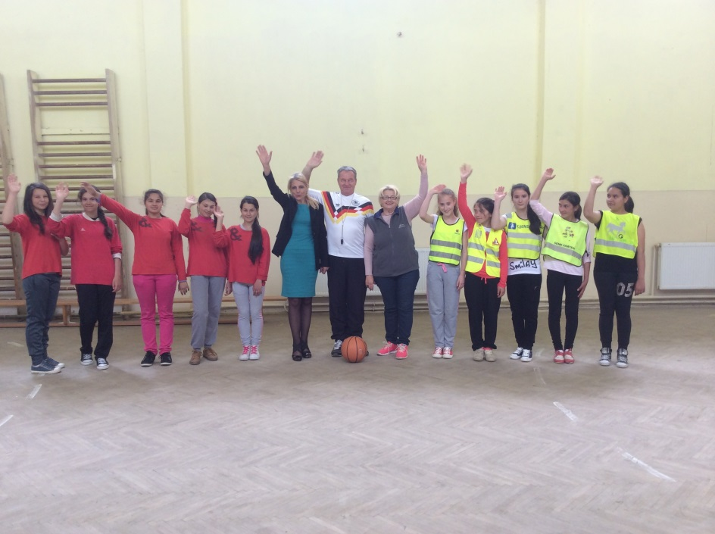
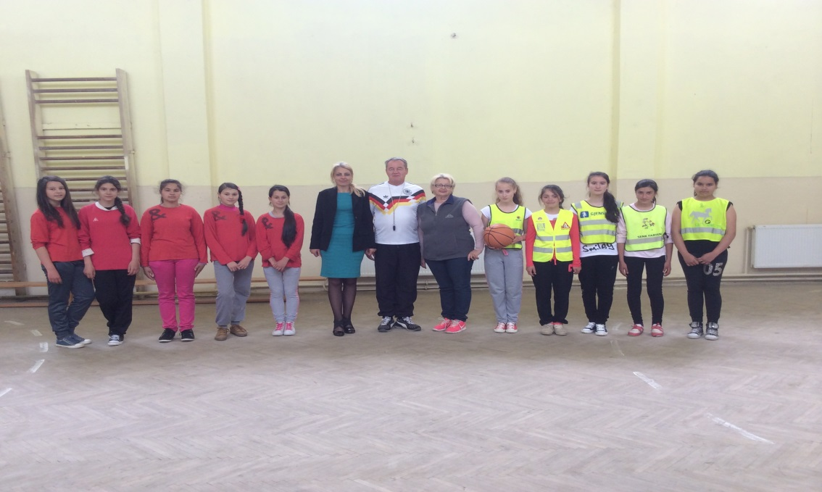

Slide 28
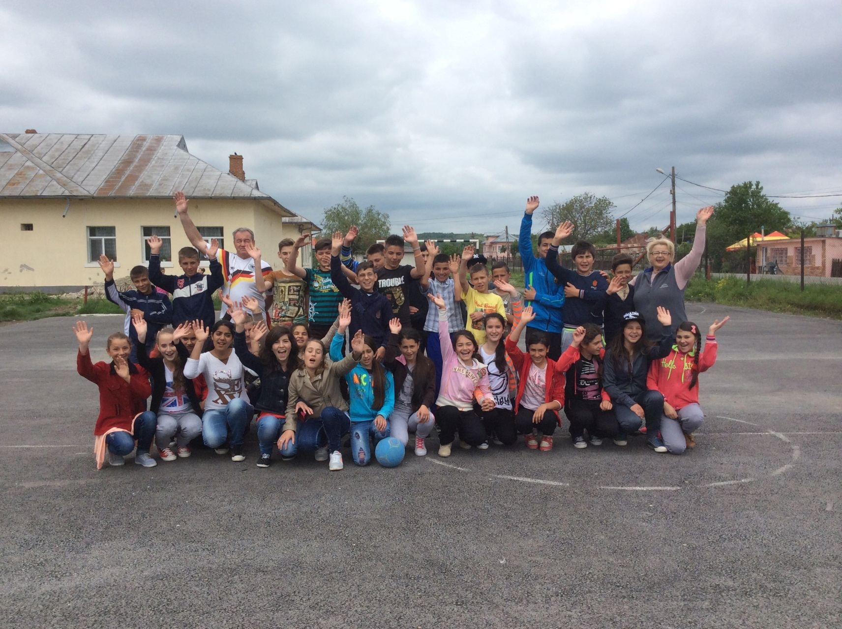

Slide 29

Thank you!
The team
Teachers
Nadia Manda-coordonator
Adriana Gherghe-manager
Flori Mitra
Marina Tuțuleasa
Students
Hîncu Samuel
Șuiu Sebastian
Lupu Cristian
Beșliu Aida
Oprea Nicoleta
Mîrzan Mădălina

