Slide 1

COMENIUS Multilateral School Partnership
Democratic Values and Linguistic Diversity
13-PM-210-DJ-ES
DEMOCRATIC VALUES
LEAFLET
LEȘILE SECONDARY SCHOOL
DOLJ COUNTY ROMANIA

Slide 2


VALUES LEAFLET
Poland
Zamosc
10-12 February 2014
SCHOOL`S VISION
“EDUCATE TODAY FOR TOMORROW`S SOCIETY”
SCHOOL`S MISSION
“ EFFICIENCY –QUALITY- PROFESSIONALISM “
SCHOOL`S PRIORITY
” CREATE A CLIMATE OF TRUST AND UNDERSTANDING”

Slide 3
DEMOCRATIC VALUES
“Democracy is a delicate plant,
do not crush it,
but help it flourish.”
Valeriu Butulescu
“Democracy is government of the people,
by the people, for the people.”
Abraham Lincoln
DEMOCRACY
Greek term = government by the people

Slide 4
S U M M A R Y
1 - Human Rights
What do they represent and which are the human rights?
2 - Democratic citizenship
What is democratic citizenship?
3 - Education for democratic citizenship
What is education for democratic citizenship?
4 - Human Rights
What is human rights education?
5 - What are the principles of democracy?
6 - Promoting education in school for democratic citizenship
and human rights

Slide 5

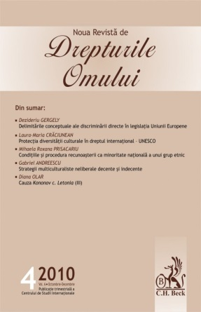


HUMAN RIGHTS
Human rights represent the core activities
of the European Council and have a big
influence on the life of people in Europe.
The main instruments prepared in this
Purpose by the Council of Europe are:
- The European Convention on Human Rights
- The European Social Charter.

Slide 6
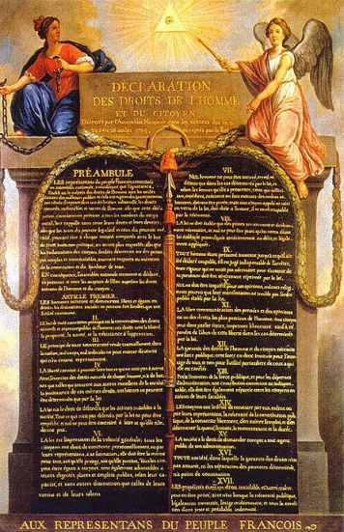
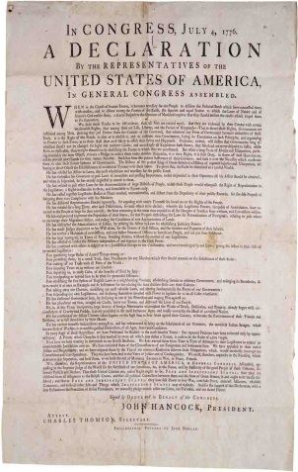
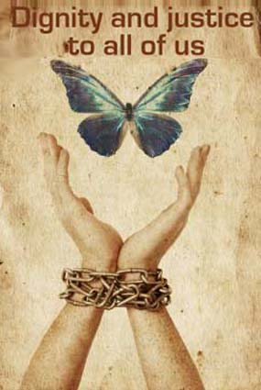
A BRIEF HISTORY
The first official statements that recorded the necessity to respect human rights date back to the Enlightenment,
the XVIII th century, during the French Revolution
- “Charter of the American colonies”and
- “Declaration of human rights and of the citizen” 1789
- After World War II, in 1948 UN proclaimed the “Universal Declaration of Human Rights”

Slide 7

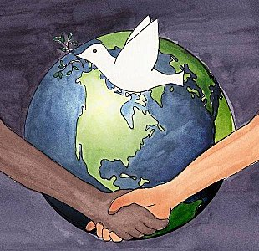
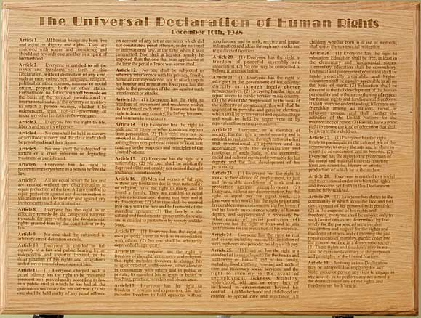

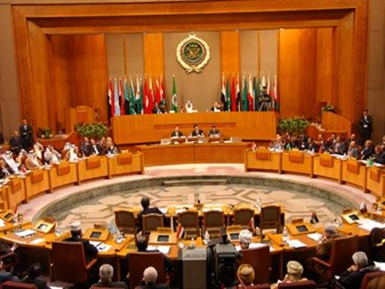
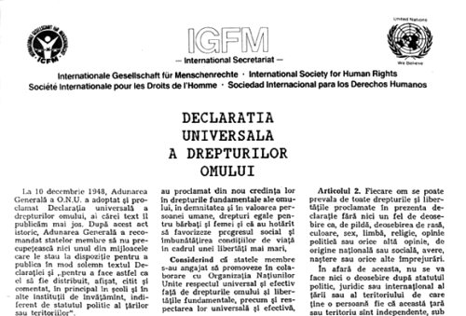


Slide 8
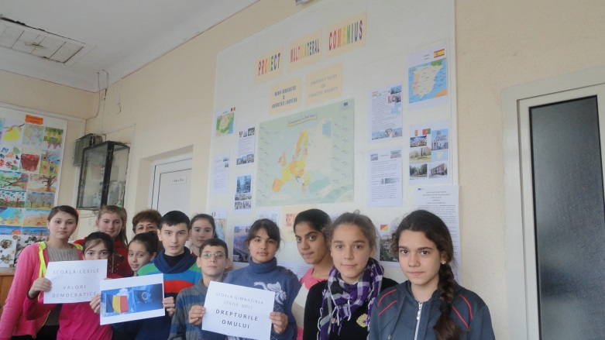
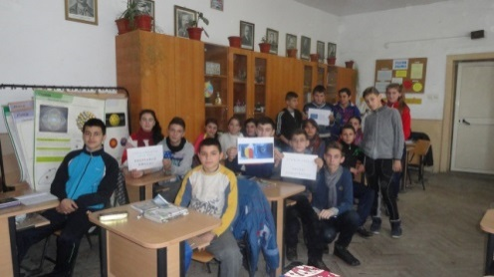
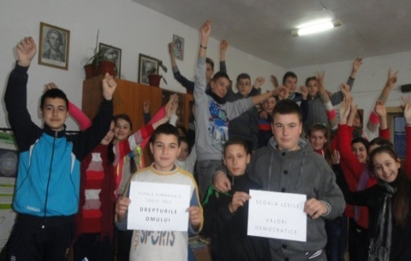
Human rights, democracy and rule of law are core values ​​of the European Union.
Personal liberty is protected and guaranteed in the EU.
Any discrimination on grounds of nationality is forbidden.
Free movement of people, goods, services and capital, freedom of establishment.

Slide 9
Democratic Citizenship Council of Europe Charter on education for democratic citizenship and human rights education
This Charter aims at education for citizenship and human rights education.
Education is considered a shield against rising violence, racism, extremism, xenophobia, discrimination and intolerance.
Education for democratic citizenship focuses primarily on the rights, responsibilities and active participation in relation the civic, political, social, economic, legal and cultural dimension of society.
One of the fundamental goals of education for democratic citizenship and human rights is focused on the acquisition of knowledge, skills and attitudes of the students, but also to empower them to take action in society to defend and promote human rights, democracy and the rule of law.

Slide 10

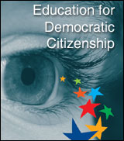
Promoting Democratic Citizenship in Schools
Education for Democratic Citizenship aims to:
- promote of a free, tolerant and fair society
- the formation, development and practice of civic skills and social-democratic attitudes which are necessary for active participation of the younger generation in society,to defend the core values ​​and principles of freedom,the human rights and the rule of law which are the foundations of democracy.
The National Programme of Education for Democratic Citizenship has as main objectives:
• awareness and respect for human rights;
• formation of a tolerant behavior to stimulate respect, understanding and cooperation;
• gradual elimination of discrimination of any kind and achievement of social integration;
• supporting and facilitating the access of children and youth in community action to promote their rights;

Slide 11
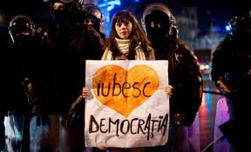

• respect for the basic rules, laws and institutions of the democratic state;
• assuming roles and responsibilities in society by students;
• stimulate student involvement in solving community problems as human resources able to build a democratic society and a better future.
The Program can be achieved through partnerships and collaboration between parties interested and involved in education for democratic citizenship and human rights at national, regional and local level.

Slide 12
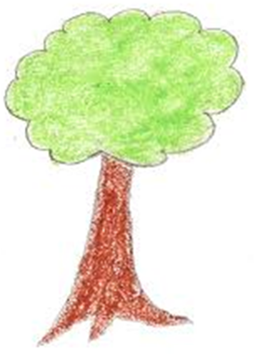
HUMAN RIGHTS
Freedom of expression
The Right to education and culture
The Right to live in peace and dignity
The Right to Freedom
The Right to LIFE
The Right to freedom of movement
The Right to VOTE and to BE ELECTED
The RIGHT to BE HAPPY
The Right to health
The Right to a Healthy environement
The Right to work
The right to property

Slide 13
FUNDAMENTAL PRINCIPLES OF DEMOCRACY
- Sovereignty.
- The rights of the minority.
- Ensuring basic human rights.
- The existence of a legal framework with rights and fundamental freedoms and equal rights for all citizens.
- Free and fair elections.
- Right to vote and to be elected: direct universal Suffrage.
- Compliance with legal proceedings.
- Constitutional limitation of the power of leaders.
- Social, economic and political pluralism
- Separation of powers as a necessity and a guarantee against totalitarianism.
- The existence of mass media.
- Organization and democratic governance encompassing all spheres of social life.

Slide 14
SCHOOL`S REGULATIONS
- Here are listed the rights and duties of pupils.
- Student Council was established, which is a form of associative organization of students, with an important role in the democratization of school and teacher-student relationship.
- With this organism, students can elect their representatives, may submit views and may make proposals for improving the quality of school life.
- The way in which these processes are performed are determined by the organizational culture of the school.
- The Student Council is an advisory body of the school.
- It runs on its own rules based on internal regulations of the school.
- Ensures the optimal functioning of school-family-community partnership.
- The council was established under the Education Law and its legal basis of operation are:
- Universal Declaration of Human Rights adopted by the General Assembly of the United Nations
December 10, 1948.
- United Nations Convention on the Rights of the Child - Collaboration with the Council of Europe reference books.

Slide 15
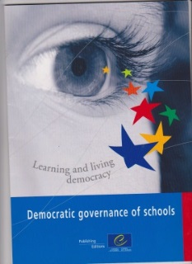
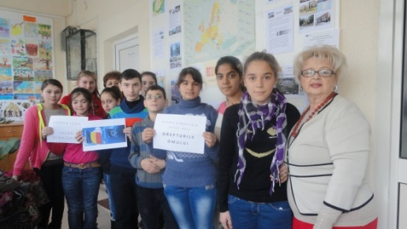
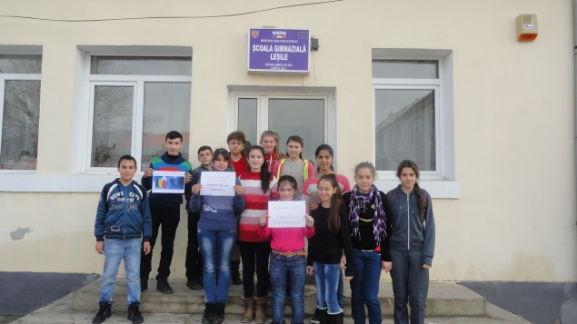



AUTHORS:
Teacher Nadia MANDA-coordinator
Teacher Adriana GHERGHE-manager
Teacher Alexandra OLARIU
Teacher Flori MITRA
Teacher Marina TUTULEASA
AND Students:
Adrian Tudoran Surligeanu
Cristian Lupu
Liliana Burcea

Slide 16
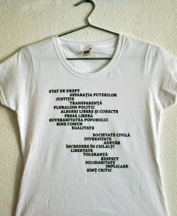


The “Democratic Values ​​and Linguistic Diversity”
is carried out with financial support from the European Commission. The content of this material is the sole responsibility of the author, and the National Agency and the European Commission are not responsible for how it will be used.

